Slide 1
Technical Training: Lesson 7 Documents

Slide 2
TREATMENT STEP BY STEP
LESSON GOALS:
Know documents available
Know Service Bulletins
Know technical website

Slide 3
Documents : Applicative
Document name | Description
TMSXXXXXX User Manual | Complete Applicative guide including: short specification probe disinfection guide transportation guide.
TMSXXXXXX Quick Guide | Quick description of treatment step by step, with reminder of good practice.
TMSXXXXXX Nurse Guide | Detailed description of majors steps usually performed by nursed, before and after treatment.
Documents
Service
Bulletin
Website
Localization : Country kit flash drive or device \FocalOne\Documentation\YY\
Where YY are country initials.
If documents in English if not available in country language.

Slide 4
Documents : Technical
Document name | Description
TMS 510650 Service Manual | Complete manual technical
TMS510642 PM Checklist TMS511991 PM Instruction | Preventive maintenance check list with instruction. Can be used for subassembly teste.
TMS510666 Probe installation instruction TMS511996 Probe installation check list | Detailed description of probe installation. Check list for quick probe installation, use TMS511991 instruction for more information.
TMS511950 Maintenance check list EST TMS511951 Mobile installation check list EST TMS511958 Electrical Safety test instructions | Check list for general EST Limited check list for installation of a mobile unit (5 installations) Instruction to perform Electrical Safety Test
Documents
Service
Bulletin
Website
Localization : Training flash drive or technical website. (check latest available version online)

Slide 5
Documents : Technical
Document name | Description
TMS511810 DSR (Device Software Record) | Describe: Hard drive content Software update reason Upgrade process written by R&D staff
TMS511796 Recommendation regarding cybersecurity and data confidentiality | Short description of cybersecurity process and recommandations.
TMS511795 DII Pack Cybersécurité | Description of cybersecurity pack installation (SessionManager) and computer setup (BIOS, Firewall…)
TMS511139 Focal One Screen wiring | Description of screen wiring modification for global F software version.
TMS510600 Settings recommendation | Description of : Hardware recommendation Firmware upload Tech. Files configuration Software configuration (IP address of computer and U/S scanner, video frame grabbing, U/S scanner applicative setting…)
TMS510563 DII Focal One | Full description of computer software installation.
TMS510003 DII DICOM | Full description of DICOM installation and configuration.
TMS 510746 B Conf-Stat-Focal-One | DICOM behavior description to send to hospital IT before configuring DICOM.
Documents
Service
Bulletin
Website
Localization : Software flash drive “Documentation” Folder.
Most of document have a French and an English part.

Slide 6
Service Bulletin
The SB or Service Bulletin is a information document.
They are written by CCC for all FSE (EDAP, distributor or subsidiaries) with a field service point of view.
Actually, 4 level of service bulletin can be sent.
The technical note
The mandatory action required
The field corrective action
The field safety corrective action
For all Service Bulletin, fill and send back Acknowledgment Receipt form.
Documents
Service Bulletin
Website

Slide 7
Service Bulletin: Feedback
For all Service Bulletin, fill and send back Acknowledgment Receipt form.
If present, fill and send back Completion Report form once modification has been performed for each device once it is updated.
Documents
Service Bulletin
Website

Slide 8
Service Bulletin: T.N.
TN : Technical Note :
This is the notification for technical evolutions of a device.
We write the description of the modifications brought during
manufacturing process, specifying the scope, with serial number.
Technical Notes are not referring to any safety, nor regulatory matters.
Documents
Service Bulletin
Website

Slide 9
Service Bulletin: M.A.R
Documents
MAR : Mandatory Action Required
This is the notification for a mandatory action which has to be taken immediately.
MAR are referring to regulatory matters.
There are 2 categories:
New releases of documents, like the maintenance checklists.
MAR can also be a technical modification that is mandatory assessed, without safety impact for FSE during maintenance (Field Support Engineer), nor for the users nor the patients as following :
Software update
Compliance (low criticality]
All corrective action for reliability improvement
Deadline for realization and return of completion form within the specified delay.
This event is not reportable to local regulatory affairs.
Service Bulletin
Website

Slide 10
Service Bulletin: F.C.A.
Documents
FCA : Field Corrective Action
This is the notification for a corrective action which has to be imperatively applied, with a specified deadline.
FCA is referring to regulatory or potential safety matters.
Split in 2 levels
Technical : Design has to be corrected because of malfunctions having potential risk for FSE, users or patient, or to solve repetitive failures, with treatment cancellation.
Regulatory : Design has to be corrected to meet compliance rules.
This event is potentially reportable to local regulatory affairs.
Deadline for return of acknowledgment, realization and completion form within the specified delay
Customers MUST be notified through a Letter of which we will draw a template.
Service Bulletin
Website

Slide 11
Service Bulletin: F.S.C.A.
Documents
FSCA : Field Safety Corrective Action.
It has been identified a serious risk for the users and/or the patient.
Systems must not be used until a safety control or a modification has been performed .
Deadline for modification as specified .
It is mandatory to report this event to regulatory affairs for all concerned countries.
Deadline for realization is within 1 month.
Service Bulletin
Website

Slide 12
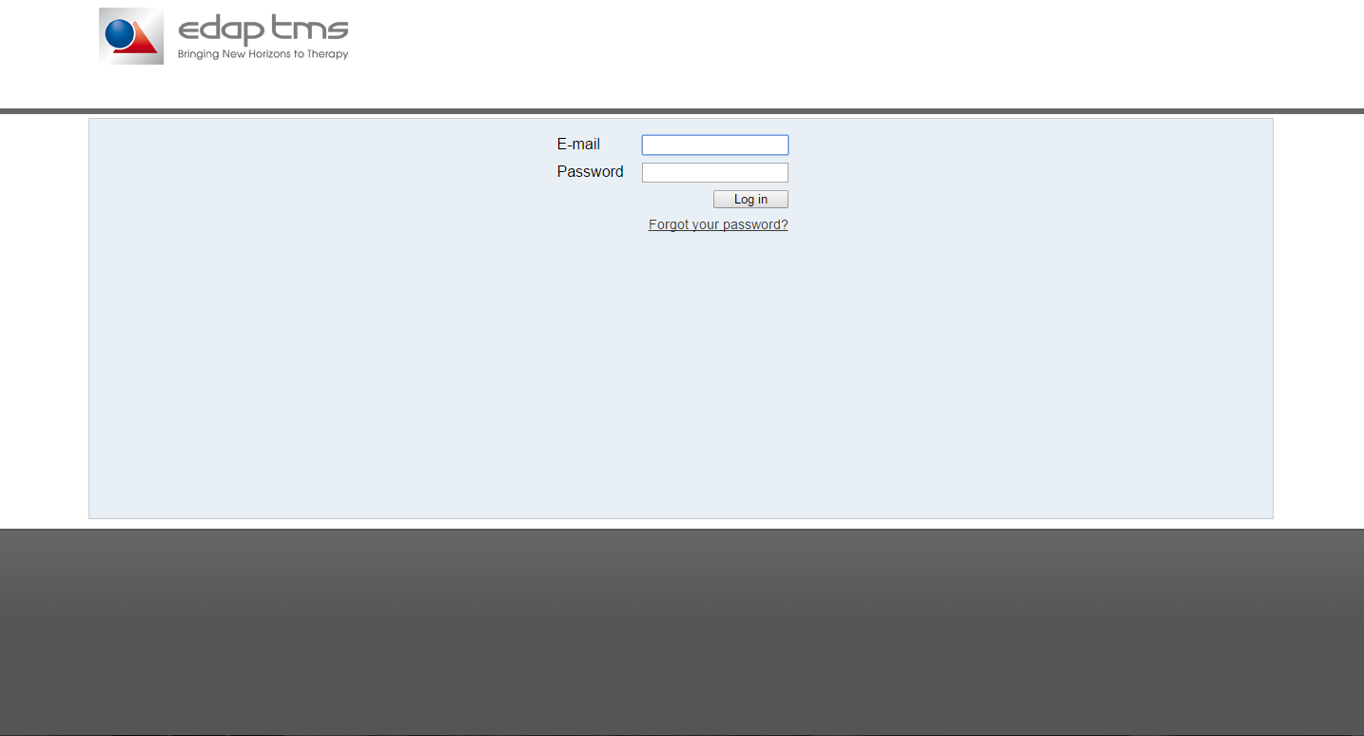
Website SWISS: Connection
https://support.edap-tms.com/connexion.php
Documents
Service Bulletin
Website
Email login will be created.
“Forgot your password” link is available to reset.
At creation or password reset, an automatic mail for password update is send (check spam box).

Slide 13
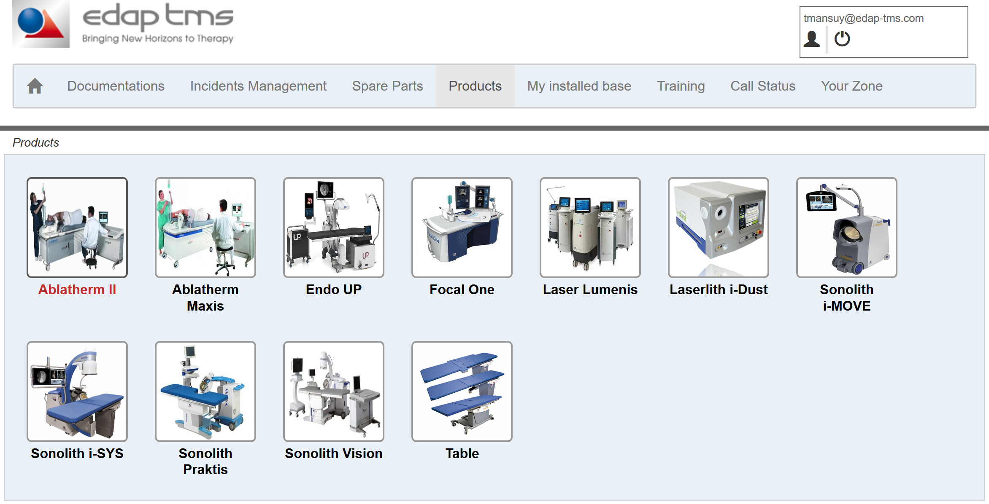
Website SWISS: content
Home page is “Product” page
Documents
Service Bulletin
Website
Only relevant devices are displayed.
Click on any item to display short description and document list
Menu bar above allows access by topics.

Slide 14
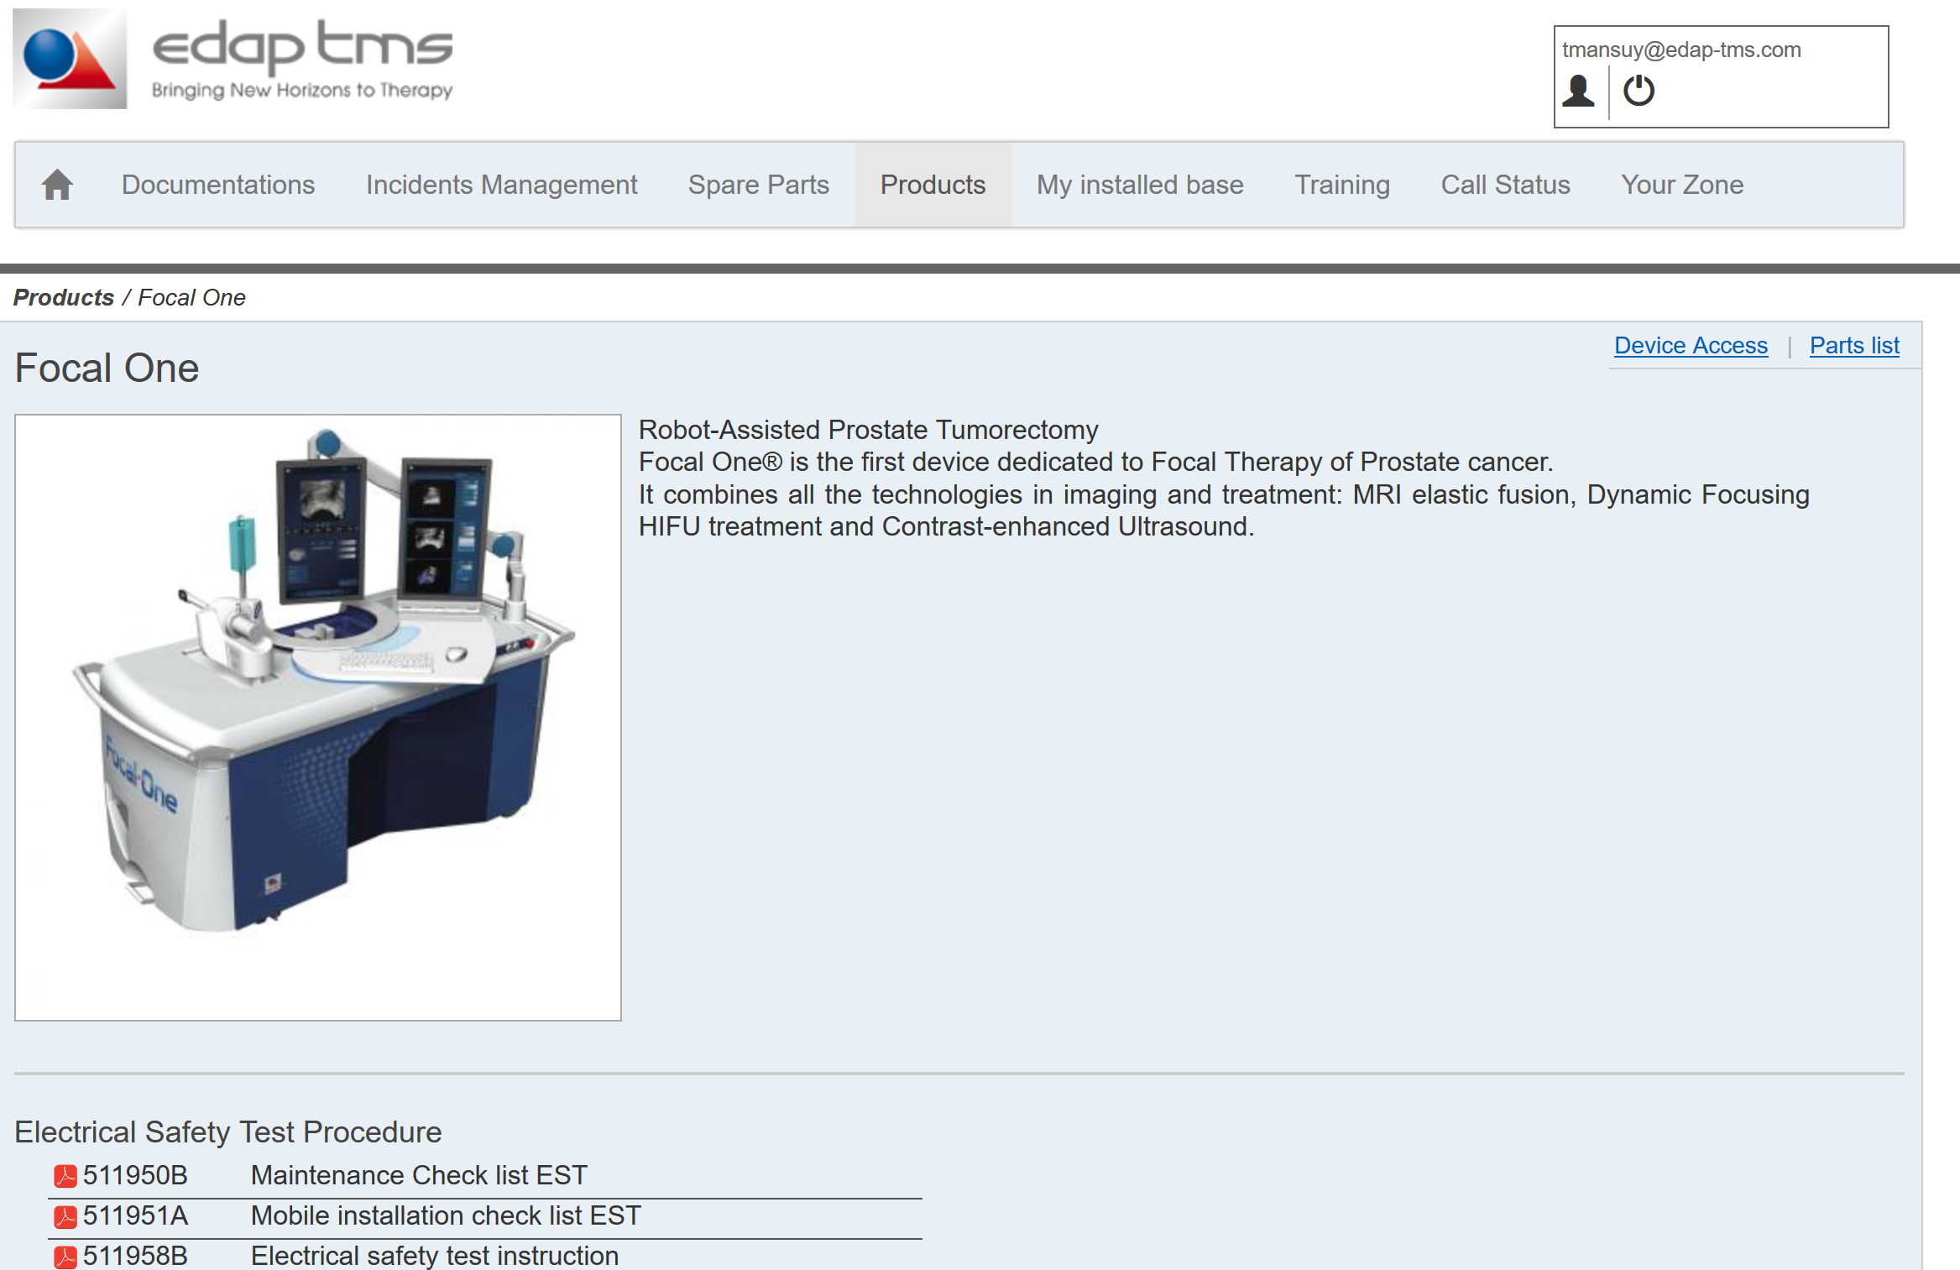
Website SWISS: Products
Documents
Service Bulletin
Some shortcut are available:
Device Access for password sheet
Part list
Document sorted by category below
Website

Slide 15
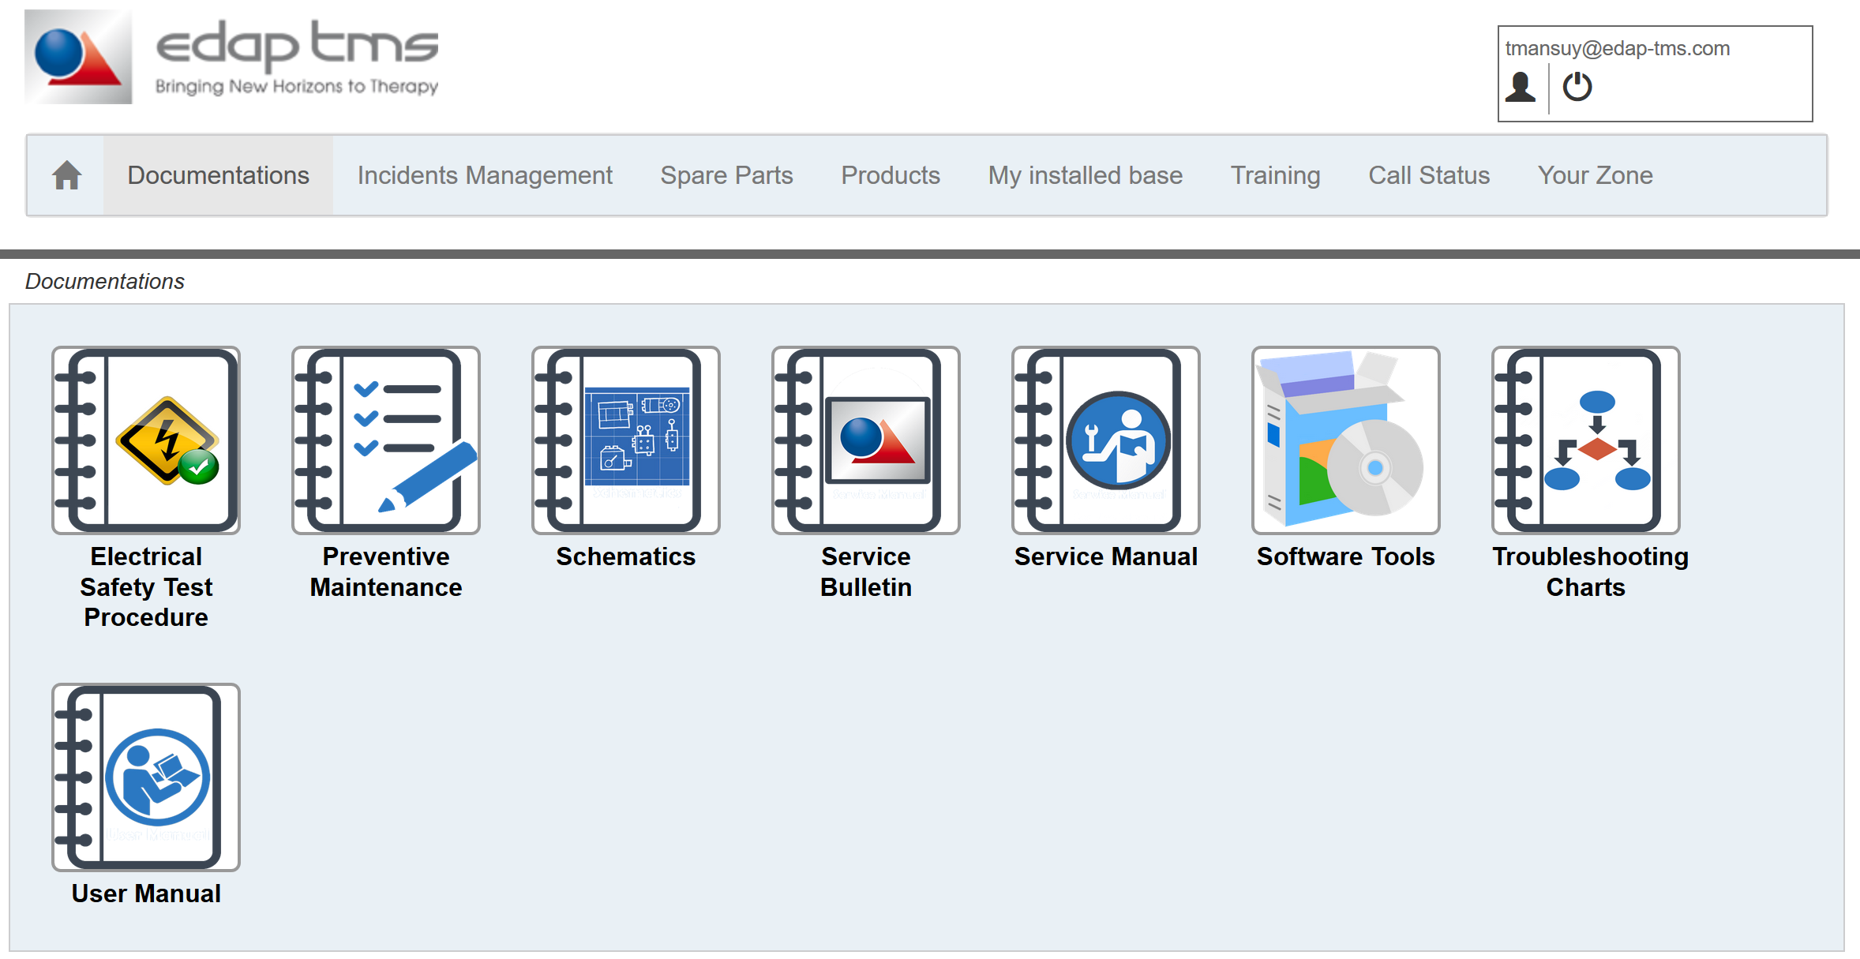
Website SWISS: Documents
Documents
Service Bulletin
Website
Documentation tab shown list of document by topic for all the products available.

Slide 16
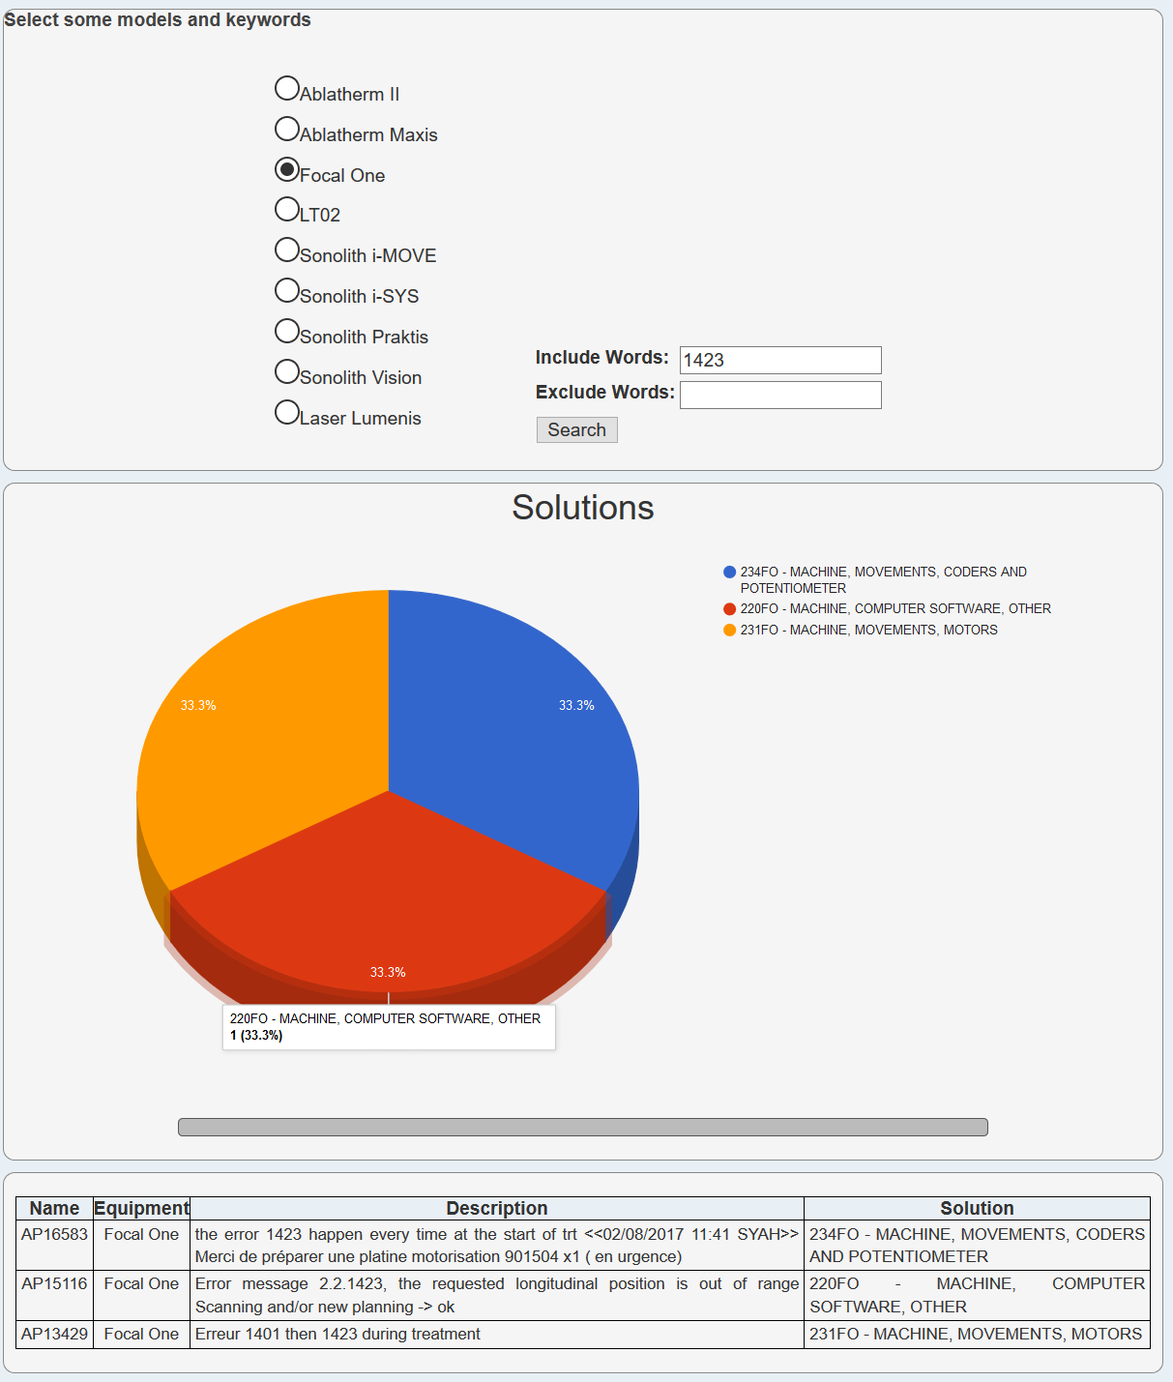
Website SWISS: Incident Management
Select product and enter key words.
Hit Search and get results from field experience.
/!\ Data are connected to old ERP only. /!\
Documents
Service Bulletin
Website

Slide 17
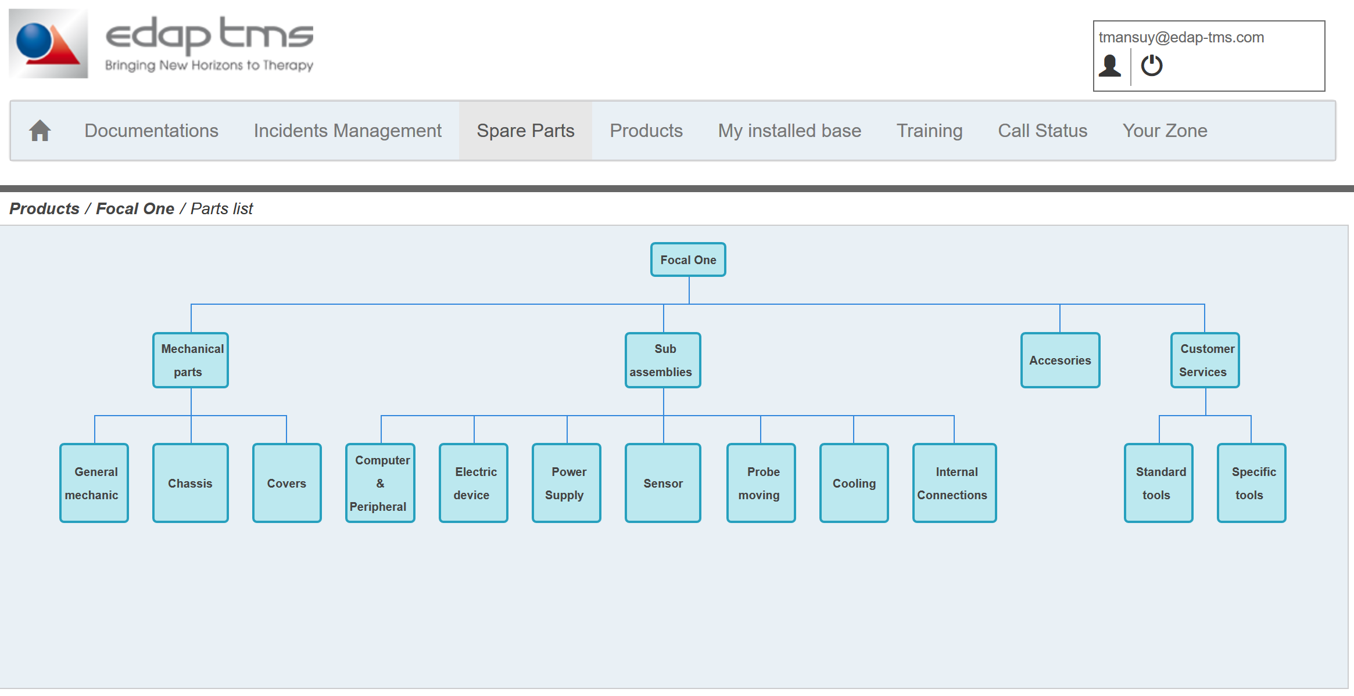
Website SWISS: Spare Parts
Documents
Service Bulletin
Website
Click on Spare Parts.
Select product.
Select in part tree to reduce list

Slide 18
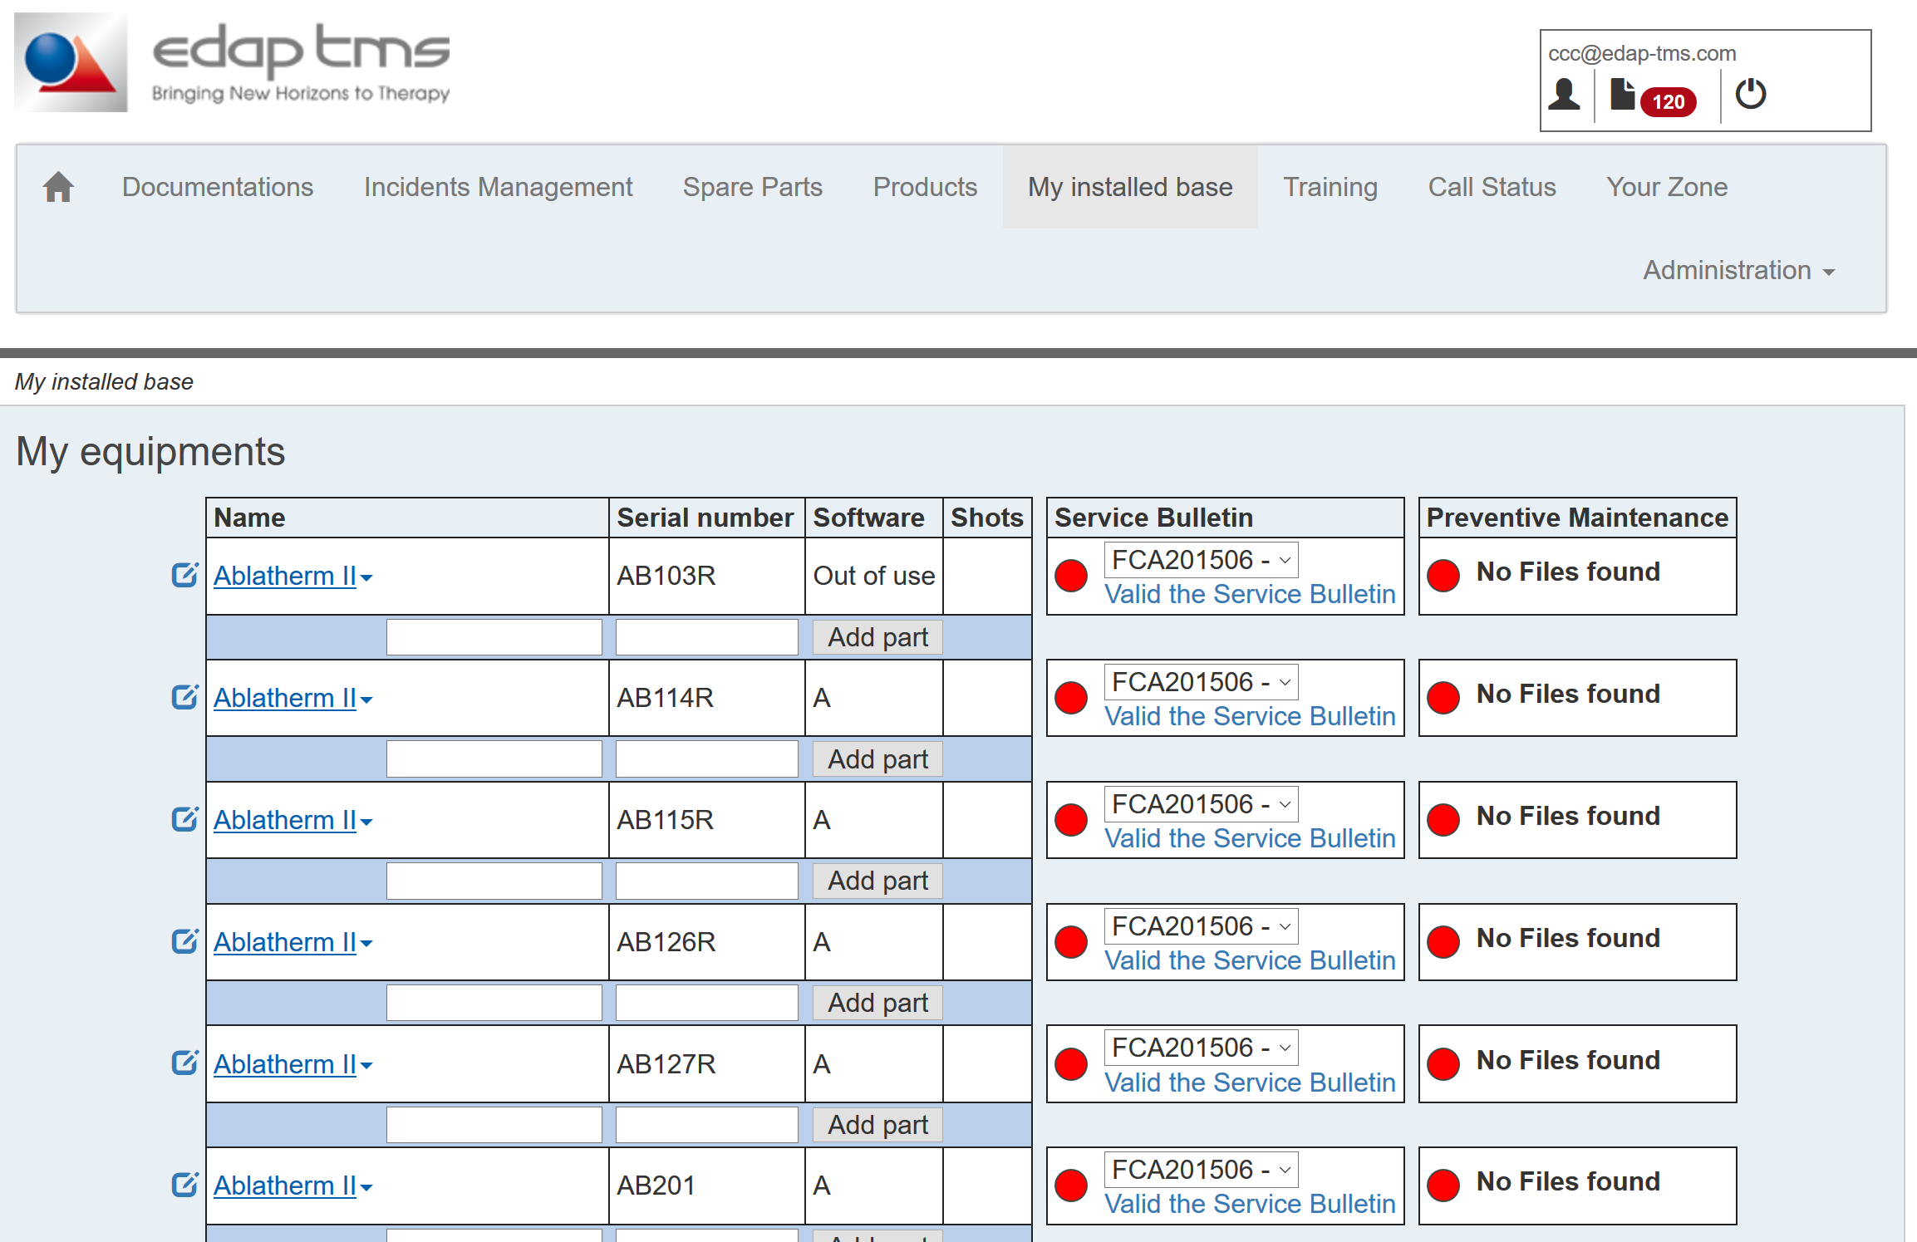
Website SWISS: My installed base
Give a list view of device associated to user.
It’s configuration can be update.
List is updated manually: check list and report differences to EDAP engineer in charge.
Do not use Service Bulletin and Preventive Maintenance. (automatic report corrupted files).
Documents
Service Bulletin
Website

Slide 19
Website SWISS: My installed base
Documents
Do not use “Training” tab: contact EDAP engineer in charge of your zone training schedule.
Do not use “Call Status” : call log with status is no longer connected to ERP. Contact EDAP engineer in charge for more information.
“Your Zone” is dedicated to EDAP engineer in charge of a dedicated zone.
Service Bulletin
Website

