Slide 1
Technical Training Lesson 5: Software

Slide 2
SOFTWARE
LESSON GOALS:
Know software basics
Know firmware installed on electronic board
Know software installed on computer
Know important files and software
Know cybersecurity

Slide 3
Basics: Firmware/Software
Firmware (on board) | Software (in computer)
MEP Fone Main control board firmware | Session Manager Cybersecurity/power off through MEP
GF Fone Firmware for cooling system. | FOne Therapy Treatment interface
Mot Fone Firmware for probe holder movements | HiFusion Image manipulation and fusion
Ampli Fone Firmware for power generator | FoneSetup Maintenance: calibration and handling
Probe Fone Firmware into Probe for managing its data | USScanner TcpIp U/S scanner dashboard
Basics
Boards firmware
Computer software
Important Files & softwares
Cybersecurity

Slide 4
Basics: Architecture
Focal One computer
(Matrox Acquisition board)
« Matrox software »
Focal One computer
(Windows 7)
FOneTherapy
FOneSetup
Session Manager
HiFusion
USScanner_TcpIp
USB
Main electronic boards
MEP_Fone
Basics
CAN Bus
Boards firmware
Ethernet
DVI
Cooling unit
GF_One
Computer software
Ultrasound
USB
Important Files & softwares
Probe’s motors
MOT_FOne
DF Probe
Probe_FOne
Amplifier
Ampli_FOne
Cybersecurity
RS232

Slide 5
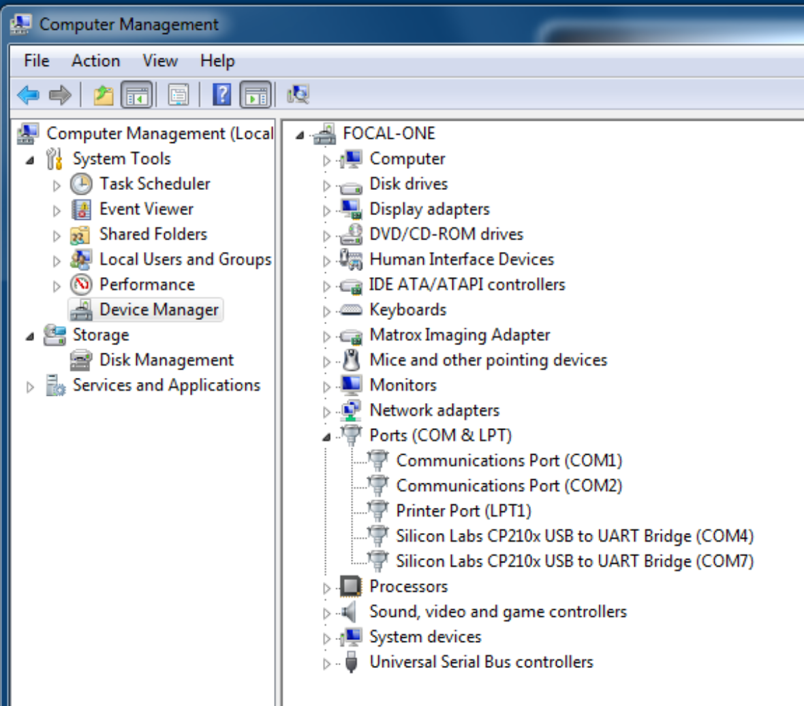
Basics COM port assignment
COM port assignment:
COM port can be seen in computer manager, Ports COM & LPT.
MEP and Amplifier are display the same: the same chip is used for interfacing.
Tip for identifying: press E/S button to deactivate amplifier, MEP will remain displayed.
/!\ Port COM assignment in computer manager and Technical Files must match. /!\
/!\ If computer is restarted for any reason, Windows can change COM assignment
Basics
Boards firmware
Computer software
Important Files & softwares
Cybersecurity

Slide 6
Basics: TCP/IP address
For communication purpose some network adapter are set in fixed IP mode:
U/S scanner and computer network adapter to U/S scanner.
Network adapter to DICOM connection is set in DICOM lesson.
/!\ U/S scanner IP address ≠ Computer network adapter IP address /!\
Basics
Boards firmware
169.254.42.1
169.254.42.25
Setting must be the same in:
U/S scanner network adapter
FO, U/S scanner dashboard setting (for all windows users).
FOneSetup\TechFile\US Imaging Tab.
SessionManager config file.
Firewall exception rules.
Set for computer network adapter connected to U/S scanner.
Computer have 2 network adapter, to find the right adapter, disconnect DICOM connection, the remaining one is for U/S scanner.
Computer software
Important Files & softwares
Cybersecurity

Slide 7
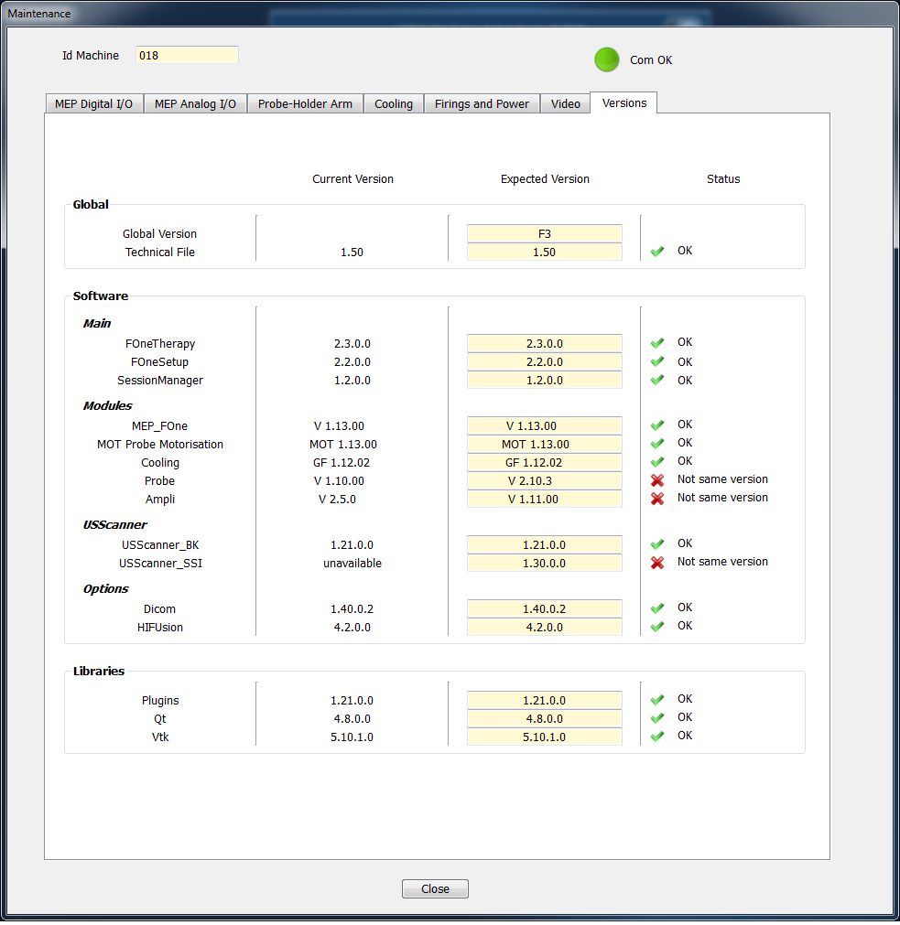
Basics: version summary
All software versions are summarized in FOneSetup software:
in Maintenance part, Version tab
Basics
Boards firmware
Computer software
Important Files & softwares
Cybersecurity

Slide 8
Board firmware
Board firmware are usually pre-loaded.
Firmware are mature and no major change are expected.
Firmware upgrade are described in service manual, service bulletin and documentation of software flashdrive.
Required material:
A to A type USB cable (motor, cooling board)
Small torx screwdriver (amplifier)
Basics
Boards firmware
Board connection:
MEP, use genuine connection.
Motor, use remote USB port near U/S scanner USB port (above fuses)
Cooling, use onboard port board behind the MEP/Extension “door”.
Amplifier, turn OFF, remove master board, trip programming dip switch, place back, turn ON, use genuine connection.
Probe board: in EDAP TMS only.
Computer software
Important Files & softwares
Cybersecurity

Slide 9
Computer software : Behavior
Focal One Windows User:
Automatic login (windows setting)
Start automatically Session Manager (according user settings: no windows desktop, Windows and Ctrl keys disabled…).
FOne Therapy start automatically on left screen (Session manager setting).
After Hospital login FOne Therapy starts HiFusion on right screen.
Administrateur Windows User (requires password)
Require to log off twice.
Start automatically Session Manager (according user settings: windows desktop, Windows and Ctrl keys enabled, all options available…).
Basics
Boards firmware
Computer software
Important Files & softwares
Cybersecurity

Slide 10
Computer software
Use a Windows 7 (up to F3 version) / Windows 10 (version G and above)
Applicative | Non applicative
FOne Therapy Treatment interface | FOne Setup Maintenance: calibration and handling
HiFusion Image manipulation and fusion
USScanner TcpIp U/S scanner dashboard | LPC 2000 and Flashmagic Firmware upgrade
Session Manager Cybersecurity/power off through MEP | Intellicam Frame grabber driver and utility
HiFusion Desktop For external contouring purpose on external computer: standalone software with landscape screen configuration. | Touch screen driver According hardware version
Basics
Boards firmware
Computer software
Important Files & softwares
Cybersecurity
Automated software update, perform manual back to D: for safety.

Slide 11
Computer software: FOne Therapy
Applicative software: Treatment
Hospital login required.
No settings.
DICOM settings for worklist and PACS in FOne Setup
1 Hospital = 1 database
Use EDAP hospital for maintenance only.
For EDAP hospital only: Level button allows to unlock maintenance protocol
Level 0: only real treatment protocols available (according regional allowance).
Level 1: add extra maintenance protocols for treatment simulation (ignore temperature limit and/or rectal wall detection).
Basics
Boards firmware
Computer software
Important Files & softwares
Cybersecurity

Slide 12
Computer software: HiFusion
Applicative software: fusion and review.
DICOM settings.
Treatments can be recalled only for the logged hospital.
For F3 software version Language setting customize in C:\FocalOne\HiFusionConfigFile.ini
Basics
Boards firmware
Computer software
Important Files & softwares
Cybersecurity

Slide 13
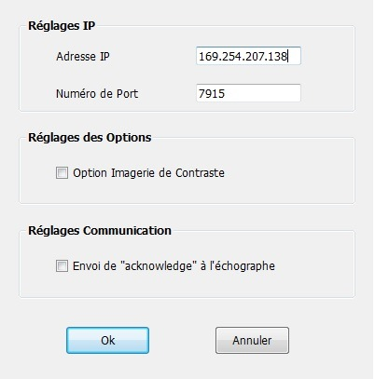
Computer software: USScanner TCPIP
Applicative software: U/S scanner dashboard.
/!\ Setting are windows user relevant: do modification for administrateur then log as Focal One change temporarily SessionManager configuration, start USScanner_TCPIP in standalone mode and redo modifications, restore SessionManager configuration perform treatment simulation to validate modification.
Basics
Boards firmware
Computer software
Important Files & softwares
169.254.42.25
Cybersecurity

Slide 14
Computer software: SessionManager
Applicative software: cybersecurity and power management.
More or less options are available according windows user login (see Cybersecurity section).
Basics
Clinical
Technical
Boards firmware
Computer software
Important Files & softwares
Cybersecurity

Slide 15
Computer software: FOne Setup
Requires level 1 password for access,
After correct password input system perform a short initialization (test communication with subassemblies)
Technical software:
allows calibration (Technical Files)
direct subassembly control (Maintenance).
Basics
Boards firmware
Computer software
Important Files & softwares
Cybersecurity

Slide 16
Computer software: FOne Setup
Basics
Password
Boards firmware
Init
Computer software
Main page
Important Files & softwares
QUIT
Cybersecurity
Technical file
Maintenance
Language
Level

Slide 17
Computer software: FOne Setup
Technical File allows setting and calibration of system.
Technical file
PRINT
Basics
Boards firmware
MEP Config
Motors
Cooling
Probe
Amplifier
Protocols
Imaging
Options config
Computer software
Technical Files load, merge and display in a user friendly way contents of EEPROM for each subassembly and TechFile parameters of computer.
EEPROM
EEPROM
EEPROM
EEPROM
Important Files & softwares
Cybersecurity
Use Confirm button to save changes and close, use Cancel button to discard changes and close

Slide 18
Computer software: FOne Setup
Maintenance allows direct control on subassemblies for test and diagnostic.
Maintenance
Basics
Boards firmware
Computer software
MEP Digital I/O
MEP Analog I/O
Probe holder
Cooling
Firing and power
Video
Versions
Important Files & softwares
Cybersecurity

Slide 19
Computer software: FOne Setup
Usage of Maintenance and Technical File will be seen during subassemblies study.
The “Probe” tab of Technical Files is the most used.
Basics
Boards firmware
MEP Config
Motors
Cooling
Probe
Amplifier
Protocols
Imaging
Options config
Computer software
Important Files & softwares
MEP Digital I/O
MEP Analog I/O
Probe holder
Cooling
Firing and power
Video
Versions
Cybersecurity

Slide 20
Important files and softwares
Software name | Localization | Role
FOneSetup.exe | C:\FocalOne\ | Maintenance software.
FOneTherapy.exe | C:\FocalOne\ | Applicative: treatment software.
HiFusion.exe | C:\FocalOne\ | Applicative: image and fusion software. Can be started in standalone mode.
USScannerBK_TcpIp.exe | C:\FocalOne\ | Applicative: U/S scanner interface. Can be started in standalone mode.
SessionManager.exe | C:\SessionManager\ | Applicative: Cybersecurity and power management.
XXX regserver.lnk XXX unregserver.lnk (XXX is the software related) | Same folder as related software | Write or clear windows registry base information about the related software (useful for random bug or non reproducible issues).
Intellicam.exe | C:\Program Files\ | Frame grabber software.
TouchKit xor eGalaxTouch B1 B3X and above | C:\Program Files\ | Touchscreen calibration. (can not co-exist)
Basics
Boards firmware
Computer software
Important Files & softwares
Cybersecurity

Slide 21
Important files and softwares
File name | Localization | Role
DICOM.ini | C:\FocalOne\DICOM\ | DICOM configuration file
Pdf files | C:\FocalOne\Documentation\ | User documentation (nurse guide, user manual…) each in a subfolder according language name.
QM files | C:\FocalOne\Language\ | Language files, each in a subfolder according software name.
Txt files CRC.exe PM trajectory.prm | C:\FocalOne\Maintenance\ | Maintenance generated files (calibration, firing, motor random). CRC writer software for file corruption issues. Test trajectory for firing test.
Protocol.ini 01.Standard.trt 91.TestNoRectNoTemp.trt 92.TestNoRect.trt 93.TestNoTemp.trt | C:\FocalOne\Protocol\ | Protocol language file. Standard treatment protocol Maintenance protocol Maintenance protocol Maintenance protocol Note: extra protocols are added from the country kit according local regulation restrictions.
Basics
Boards firmware
Computer software
Important Files & softwares
Cybersecurity

Slide 22
Important files and softwares
File name | Localization | Role
TechFile.dat TechFile.sav Profocus ultraview orion.dcf DVI_D_1280x1024p.dcf | C:\FocalOne\TechFile\ | Computer related part of technical file. Frame grabber configuration file
XXXTreatmentYYY.dat | C:\FocalOne\TreatmentData\XXX\ | Hospital database file, where XXX is hospital name and YYY is system serial number
BK.ini | C:\FocalOne\USScanner\ | Current configuration file for US scanner
BK.ini BK.ini | C:\…\USScanner\BK_EB2300 C:\…\USScanner\BK_Ultraview | Configuration file for EB2300 Configuration file for Ultraview
ErrorFOYYY Focalpak.txt Focalpak.dat HiFusionConfigFile.ini HospitalData.dat | C:\FocalOne\ | Error log (where YYY is system serial number) Focalpak usage logfile readable (patient data) Focalpak usage logfile not readable HiFusion config (DICOM, network storage, Nurse guide display at startup, other option). Hospital login data
QM files | C:\SessionManager\Language | Language files, each in a subfolder according software name.
SessionManagerConfig.ini | C:\SessionManager\ | Configuration file for Session Manager.
Basics
Boards firmware
Computer software
Important Files & softwares
Cybersecurity

Slide 23
Important files and softwares
File name | Localization | Role
All | D:\FocalOneImg\XXX\XXXYYY | Treatment files (images and outputs) where XXX is hospital name and YYY is patient number (patient data). Recover .txt files, remove patient name for treatment analysis.
All | D:\FocalOneImg\Biopsies Koelis\ D:\FocalOneImg\MRI\ | Files for fusion tests.
Basics
Boards firmware
Computer software
Most of the .ini files are configured in user friendly way in FOne Setup on related software.
Important Files & softwares
Cybersecurity

Slide 24
Cybersecurity
Protect computer, software, patient data. (IEC-80001 and FDA approval)
Basics
Direct threats:
Restrict access to BIOS (password __________).
Boots only from hard drive. (Serial peripheral disabled in BIOS).
Restrict applicative user right (ctrl and win key locked, windows desktop disabled).
Indirect threats
Restrict USB (auto-run and auto-play deactivated) to avoid malware propagation
Firewall block incoming connections, only selected outcoming connection permited:
U/S scanner dashboard through TCP/IP.
SessionManager to turn off U/S scanner through TCP/IP.
DICOM Gateway for DICOM communication (PACS/Worklist server).
HiFusion for DICOM communication (PACS/Worklist server).
Boards firmware
Computer software
Important Files & softwares
Cybersecurity

Slide 25
Cybersecurity: SessionManager
Applicative software: security and power management.
Configuration :
Click on SessionManager window
Press Key combo: ____________
Enter password: ____________
Perform setting modification
Click OK to save changes and enter password: ____________
Basics
Boards firmware
Computer software
Important Files & softwares
Cybersecurity

Slide 26
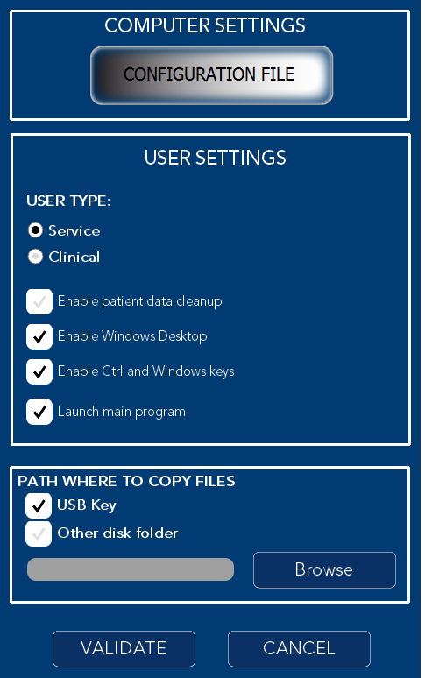
Cybersecurity: SessionManager
Options available:
Basics
Boards firmware
Computer software
Important Files & softwares
Cybersecurity

Slide 27
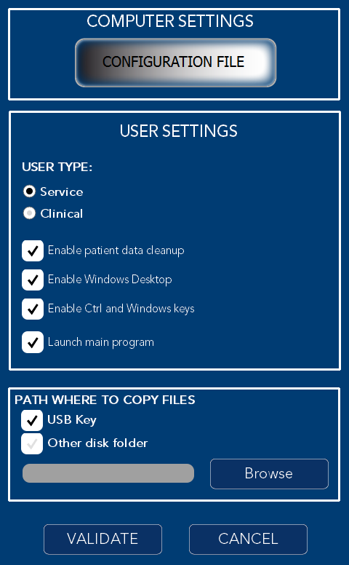
Cybersecurity: SessionManager
Typical configurations
Basics
Boards firmware
Computer software
Important Files & softwares
Cybersecurity

