Slide 1
Technical training
3 – 7 february 2014

Slide 2

Focal•One softwares

Slide 3
Softwares installed on computer
FOnePowerOff:
Initialization and power off trought MEP board.
FOneTherapy:
Treatment software.
FOneSetup:
Setup and maintenance software.
FOneXview:
Treatment images and software.
USScanner_TcpIp:
Ultrasound imaging and communication settings.

Slide 4
Softwares not installed on computer
MEP_Fone:
MEP/Extension and accessory board software.
GF_One:
Cooling system software.
MOT_Fone:
Motorization software.
Probe_Fone:
Probe software.
Ampli_Fone:
Amplifier software.

Slide 5
Softwares Overview
Focal One computer
(Acquisition board)
USScanner_TcpIp
FOneXView
Focal One computer
(Windows 7)
FOneTherapy
FOneSetup
PowerOff
Matrox software
USB
Mains electronics boards
MEP_FOne
Ethernet
DVI
CAN Bus
Cooling unit
GF_One
Ultrasound
USB
CAN Bus
Probe’s motors
MOT_FOne
DF Probe
Probe_FOne
Amplifier
Ampli_FOne
RS232

Slide 6
FOneTherapy

Slide 7

FOneTherapy
Treatment software.
Used by hospital staff.
Boots automatically when windows starts on ‘Focal One’ user.
No adjustments with this software. It used technical paramaters calibrated with FOneSetup.
Hospital password needed to access to hospital data base.
1 hospital = 1 data base.
2 levels available :
  Level 0 = Normal level of use.
  Level 1 (Mabla123) = Only available for ‘Edap’ hospital.

Slide 8
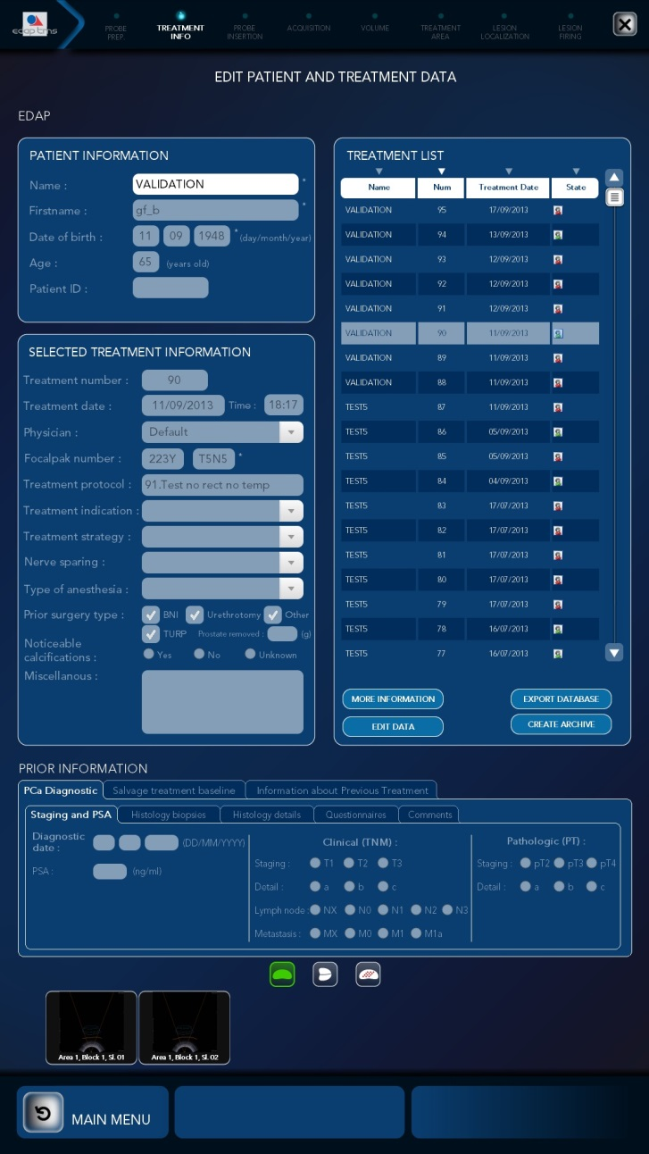
FOneTherapy – Treatment review

Slide 9
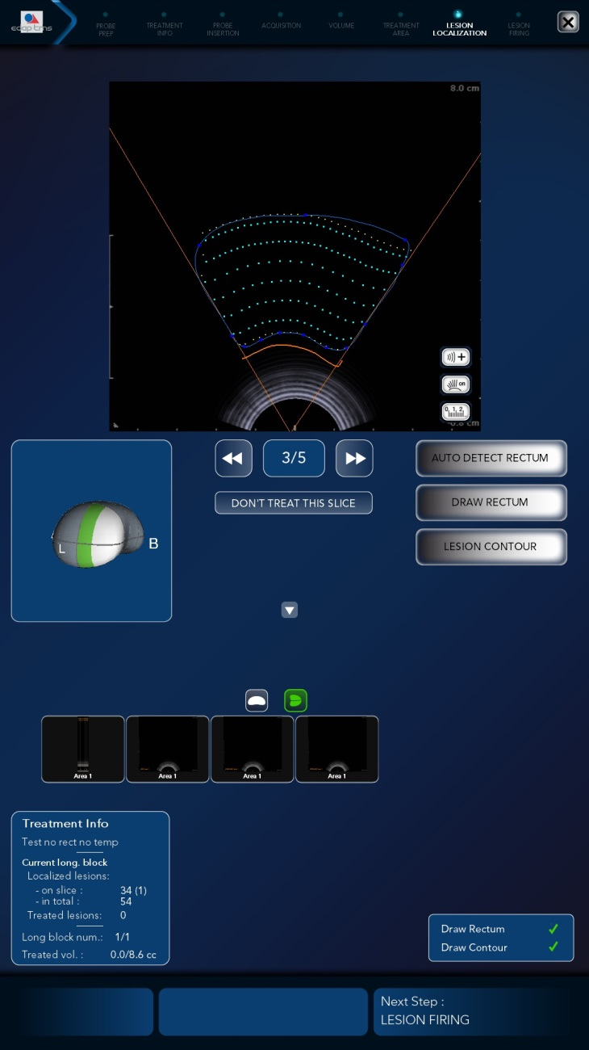
FOneTherapy – Treatment screen

Slide 10
FOneSetup

Slide 11

FOneSetup
Maintenance software.
Doesn’t start automatically.
Trained technician use only .
No treatment with this software, only service function:
  Calibrations.
  Settings.
  Parameters reading.
  2 levels available
  Level 1 (Mabla123) = Normal level of use.
  Level 2 = Only available for software team.

Slide 12
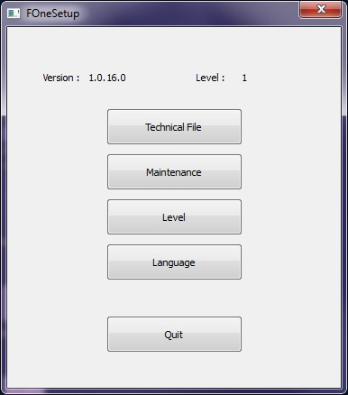
FOneSetup
Password
Init
Main page
QUIT
Technical file
Maintenance
Language
Level

Slide 13
FOneSetup – Maintenance Menu
Maintenance
MEP Digital I/O
MEP Analog I/O
Probe holder
Cooling
Firing and power
Video
Versions

Slide 14
FOneSetup – Technical file Menu
Technical file
PRINT
MEP Config
Motors
Cooling
Probe
Amplifier
Protocols
Imaging
Options config
EEPROM
EEPROM
EEPROM
EEPROM

Slide 15
FOneXview

Slide 16
FOneXView
Imaging software.
Display MRI imaging and ultrasound imaging.
FUSION
Display old treatments (ex Ablaview).
Can display biopsie reports.

Slide 17
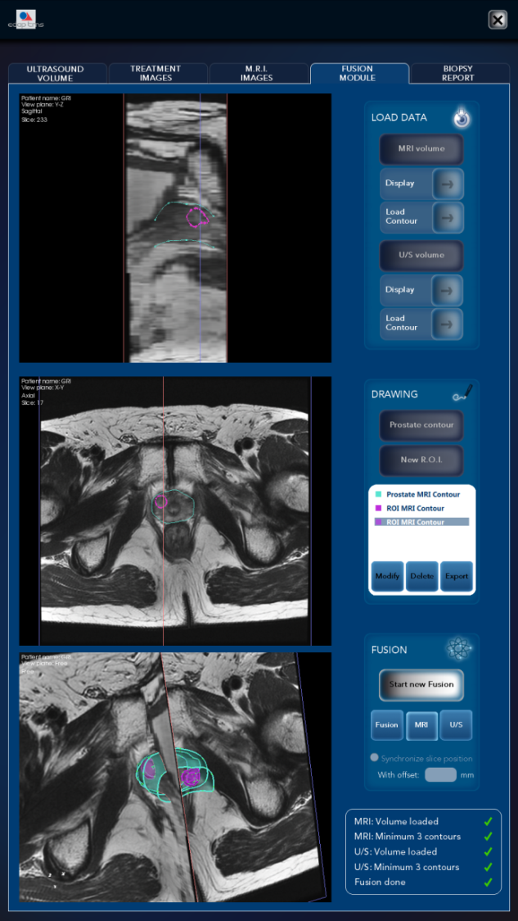
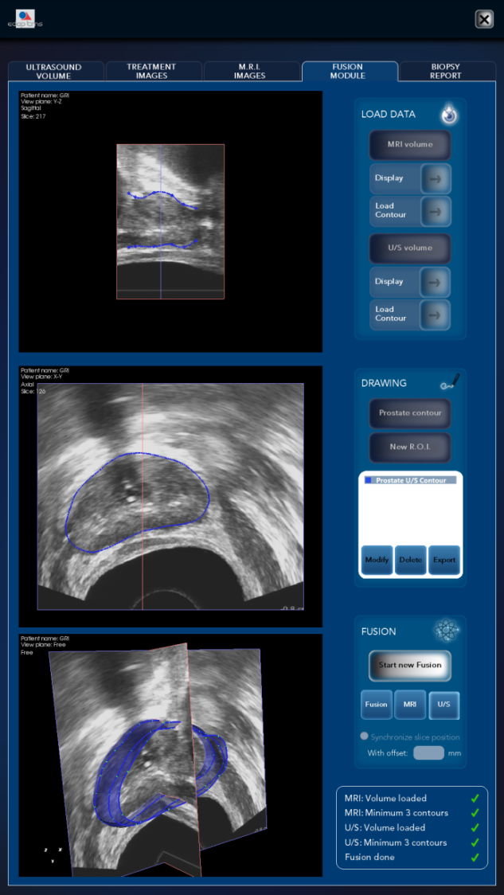
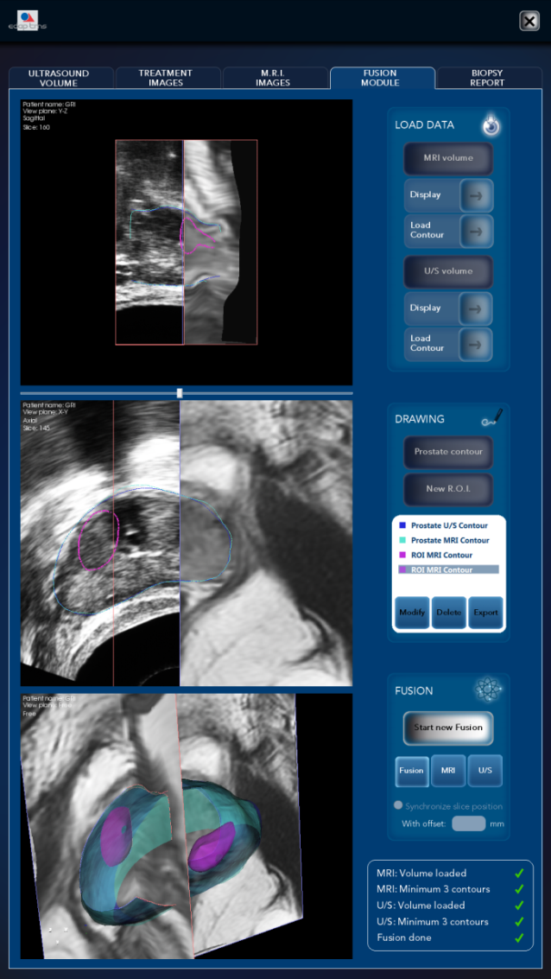
FOneXView

Slide 18
FOnePowerOff
USScanner_TCPIP

Slide 19

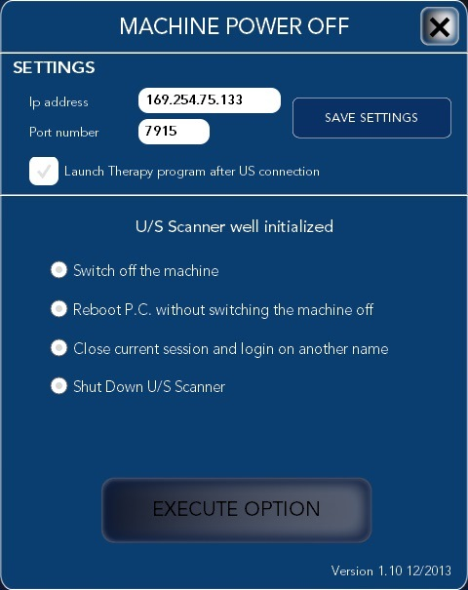
FOnePowerOff

Slide 20
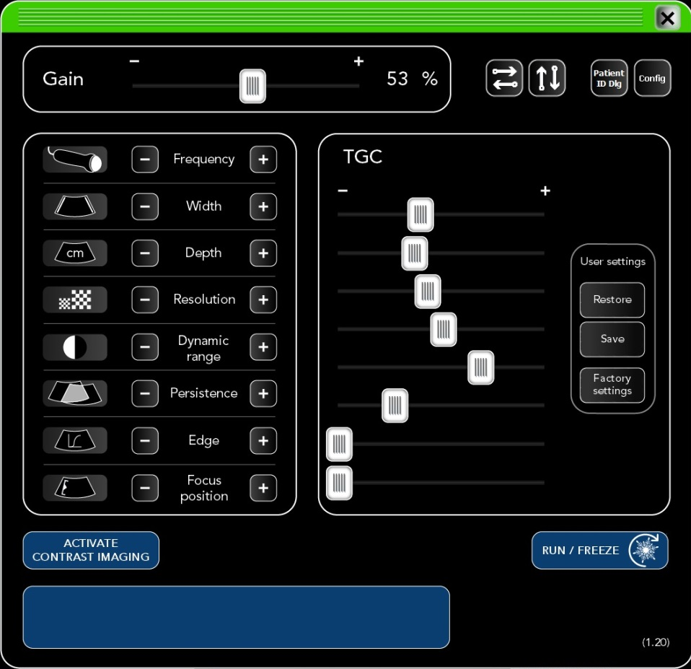
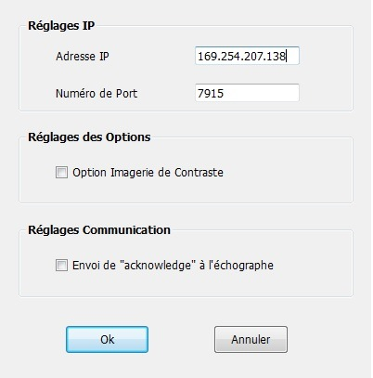
USScanner_TcpIp / Echo+

