Slide 1
Technical Training
Network configuration

Slide 2
Introduction

Slide 3
PACS focus – Explanations
PACS Picture Archiving and Communication System
Allows the storage and communication of « images » in Dicom format (.dcm files).
Dicom format allows the encapsulation of various information: PDF, contours, PNG images, all the patient information…
Worklist (WL)
The worklist allows to “download” the patient data from the PACS to the machine using its name or ID.
All info will be entered automatically.
Query / Retrieve
QUERY is a function which “ask” the server if it has the information.
RETRIEVE is a function which “move” the information from the server.

Slide 4
PACS focus – Interactions
LEVEL 1 (free)
QUERY / RETRIEVE
Load images and contours (if Dicom-RT) from the PACS
LEVEL 2 (option to purchase)
QUERY / RETRIEVE
Worklist
Link between the Focal One and the hospital patient list
Storage on the PACS (DicomGateway)
Send treatment images and PDF report to the patient file

Slide 5
Configuration

Slide 6
PACS configuration
FOCAL ONE
HIFUsion configuration
Option LEVEL 1 (free)
Calling and storage AETITLE
Storage port
Storage directory D:\DICOMPACS (must be created on the D drive).
Tech File configuration
Option LEVEL 2
Option config tab
➔DICOM
➔ “Present on the machine” box checked
PACS_1
To allow the Focal One to search patient data from PACS and once selected, to load/display these data to the Focal One into the D:/DICOMPACS folder.
FOCAL ONE MUST BE ALLOWED ON THE SERVER BY THE IT DPMT
PACS_2
To allow the Focal One to search patient data from PACS and once selected, to load/display these data to the Focal One into the D:/DICOMPACS folder.
FOCAL ONE MUST BE ALLOWED ON THE SERVER BY THE IT DPMT
PACS (WL)
To download patient data from the PACS to the Focal One.
DicomGateway needs to be configure
PACS (Store)
To export the database from the Focal One to the PACS.
8/9

Slide 7
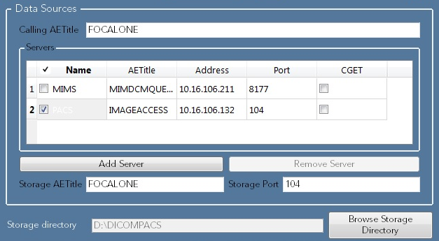
PACS configuration – HIFUsion 1_2
Information from the Focal One:
Calling AETITLE = Storage AETITLE Focal One’s computer name
Storage port 104 by default (need to be confirmed with IT)
Storage directory need to be created on the D drive

Slide 8
PACS configuration – HIFUsion 2_2
Information from the hospital:
NAME Server “nickname”
AETITLE Server name as it is on the PACS
ADDRESS Server IP address
PORT Server port COM
CGET !!ALWAYS UNTICK!!

Slide 9
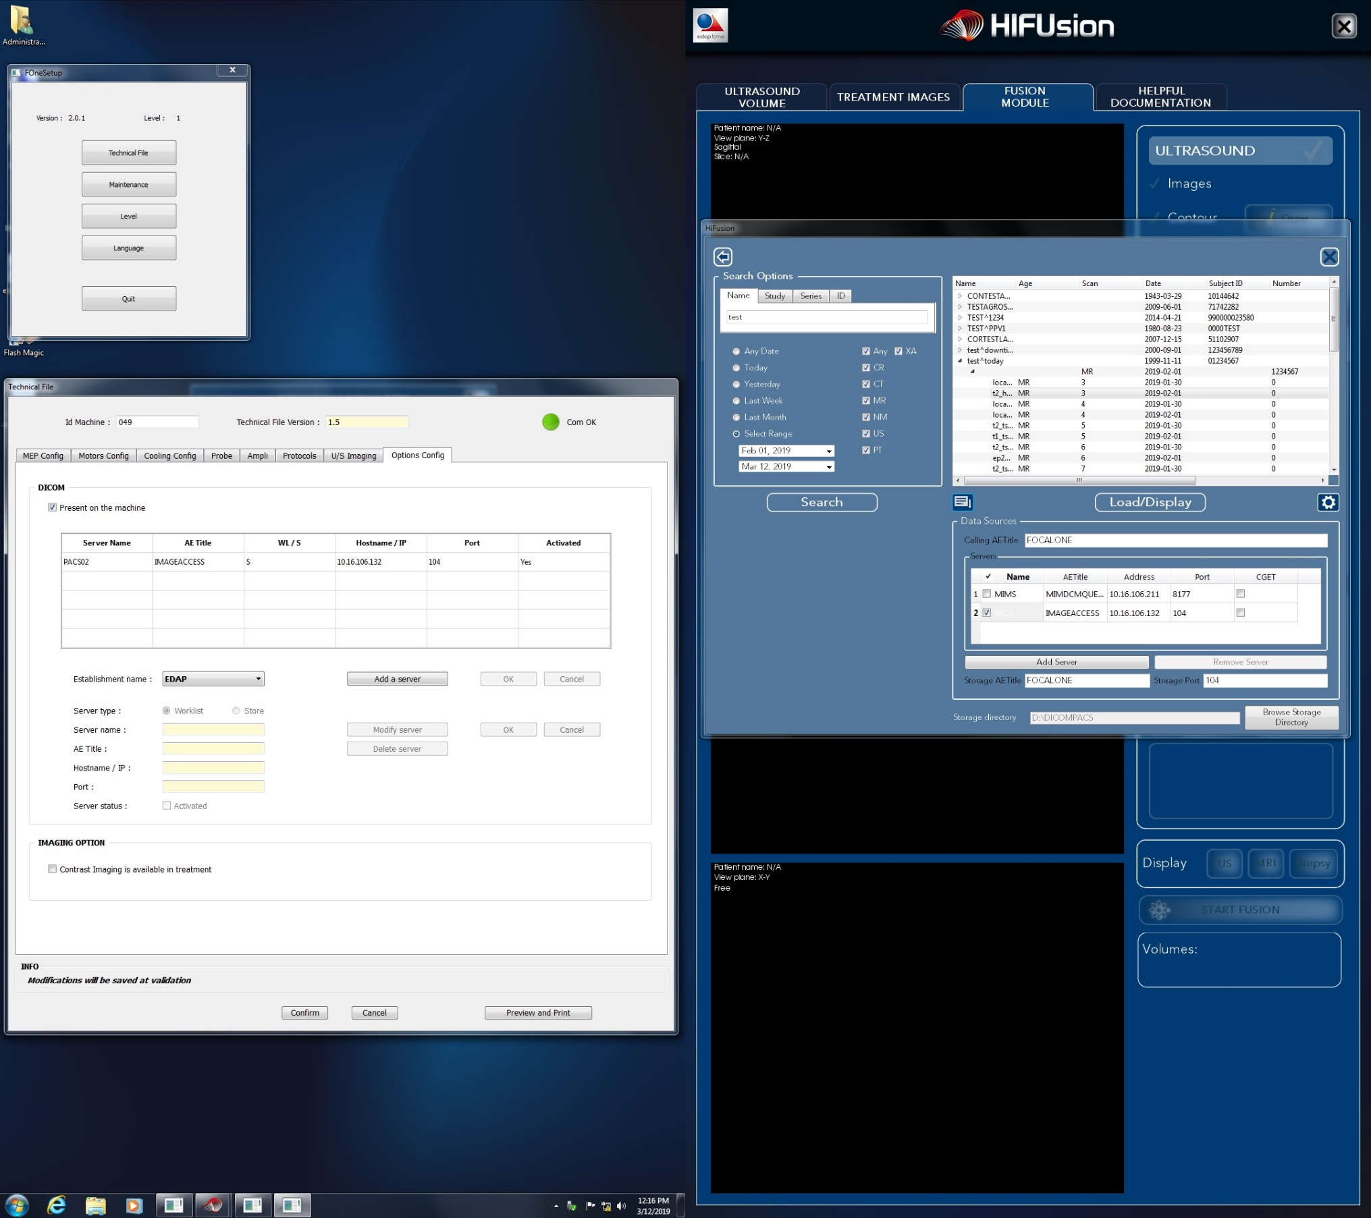
PACS configuration - FOneTherapy
IMPORTANT:
The configuration MUST be done per hospital.
Information from the hospital:
TYPE Store or WL
NAME Server “nickname”
AETITLE Server name as it is on the PACS
HOSTNAME / IP Server IP address
PORT Server port COM
SERVER STATUS Activated if you want to use it.

Slide 10
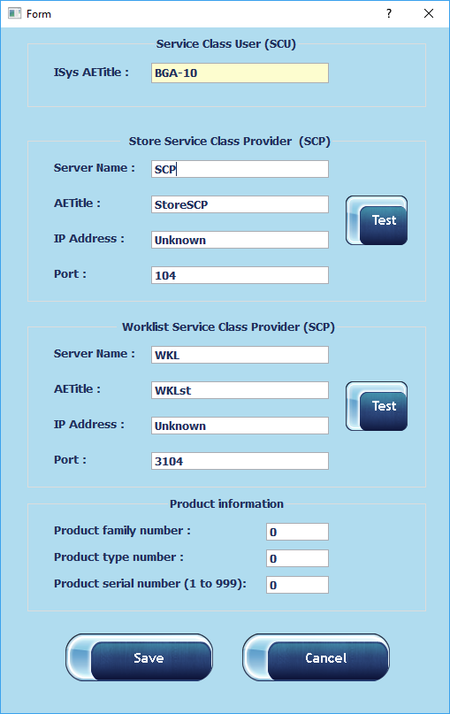
PACS configuration – Dicom Gateway
Same information than the technical file for the store and the WL servers.
Product information:
PRODUCT FAMILY NUMBER
2
PRODUCT TYPE NUMBER
3
PRODUCT SERIAL NUMBER
XXX (your Focal One serial number)

