Slide 1
Technical training
Software Update

Slide 2
Service Management presentation

Slide 3
Service Portail:
SWISS

Slide 4
Summary
Log in
The main page
The Dashboard
Machine’s presentation
Part list
Required parts
Part list tree
My profile
Documentation
Incident Management
My installed base
Information of your system
Mailing Form
Book a training
Objectives
❶ Presentation of the technical portal
❷ How to use properly the technical portal

Slide 5
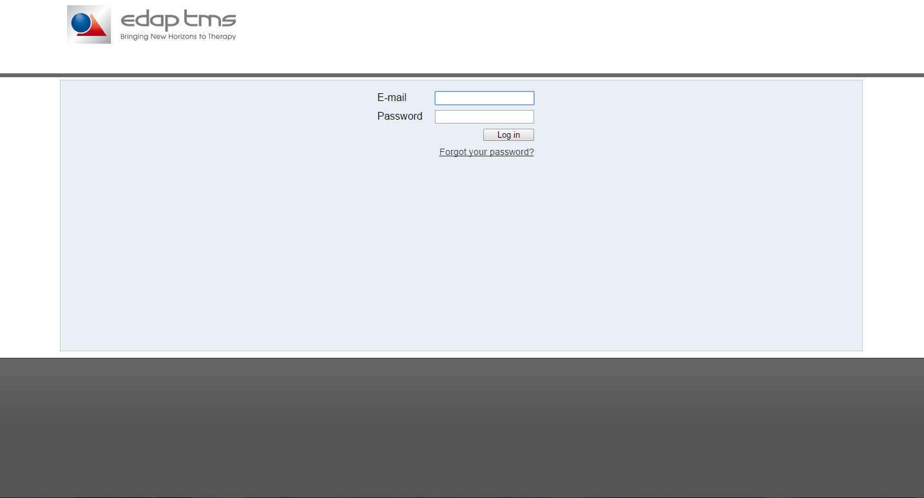
Login
Log in The main page The Dashboard Machine’s presentation Part list Required parts Part list tree My profile Documentation My installed base Information of my system
Your ID and password will be given at the end of the training.

Slide 6
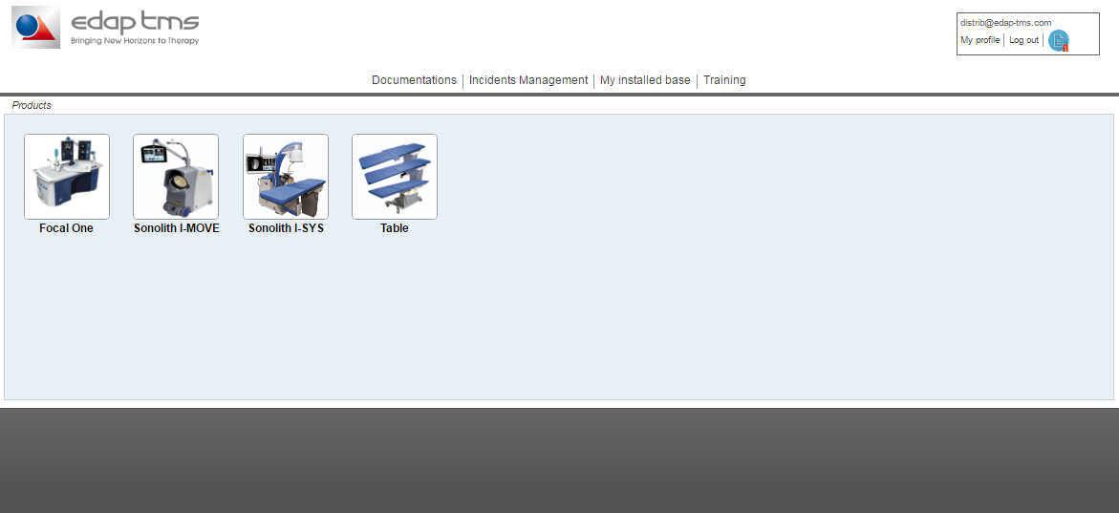
The Main Page
This are the machines you have on your zone.
If you click on one machine, you will access to all technical documents available

Slide 7
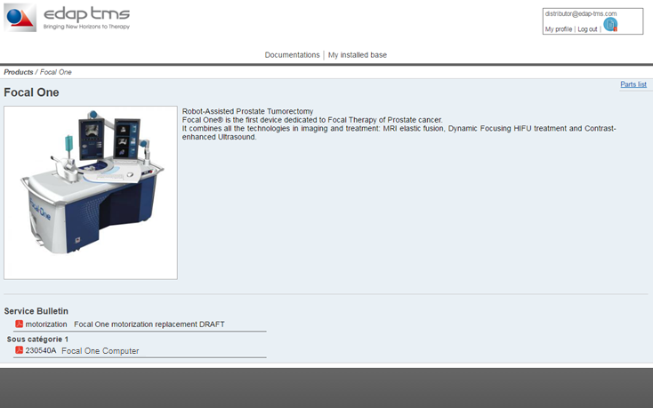
Machine’s presentation
Click here to reach the part list page
And the password
The latest service bulletin of the device are displayed here

Slide 8
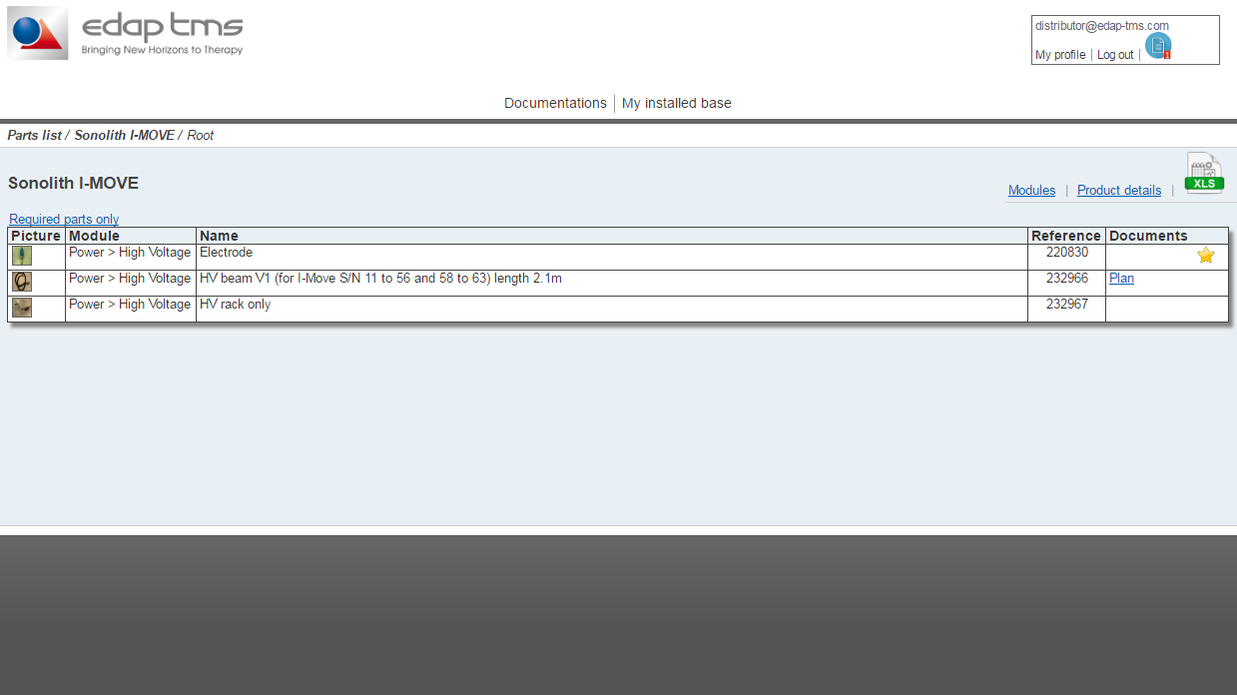
Part list
this button is to display the recommended spare part list only
Click here to go on the part list tree
In this table you will find all Spare parts of the product, its picture , its TMS reference and a document (when available)

Slide 9
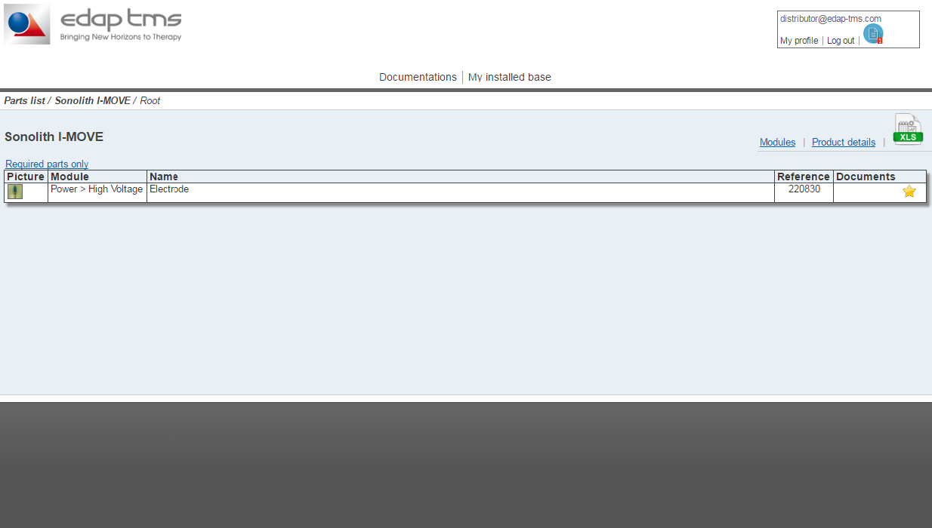
Recommended Parts
This is the spare part list file for an offline use
The star indicate that the reference is included into the RSPL

Slide 10
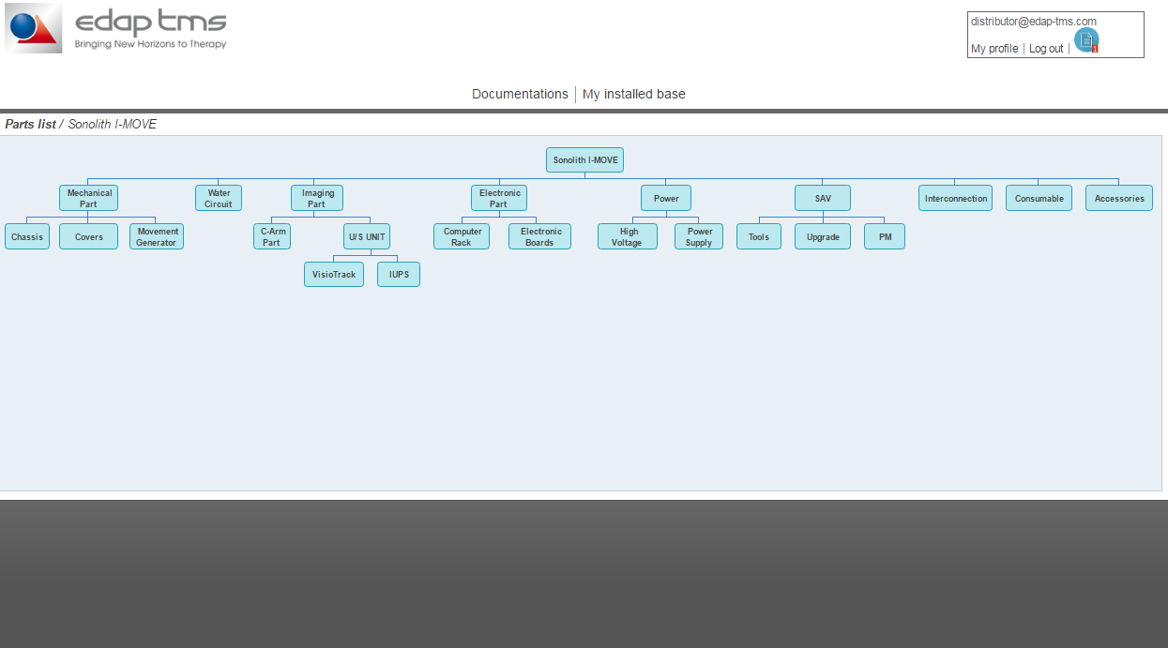
Parts list tree
Click on a category to access to the part list

Slide 11
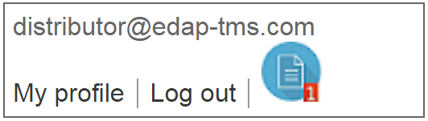
Your dashboard
This is the notification of a new service bulletin to apply.
In your profile you can change your password

Slide 12
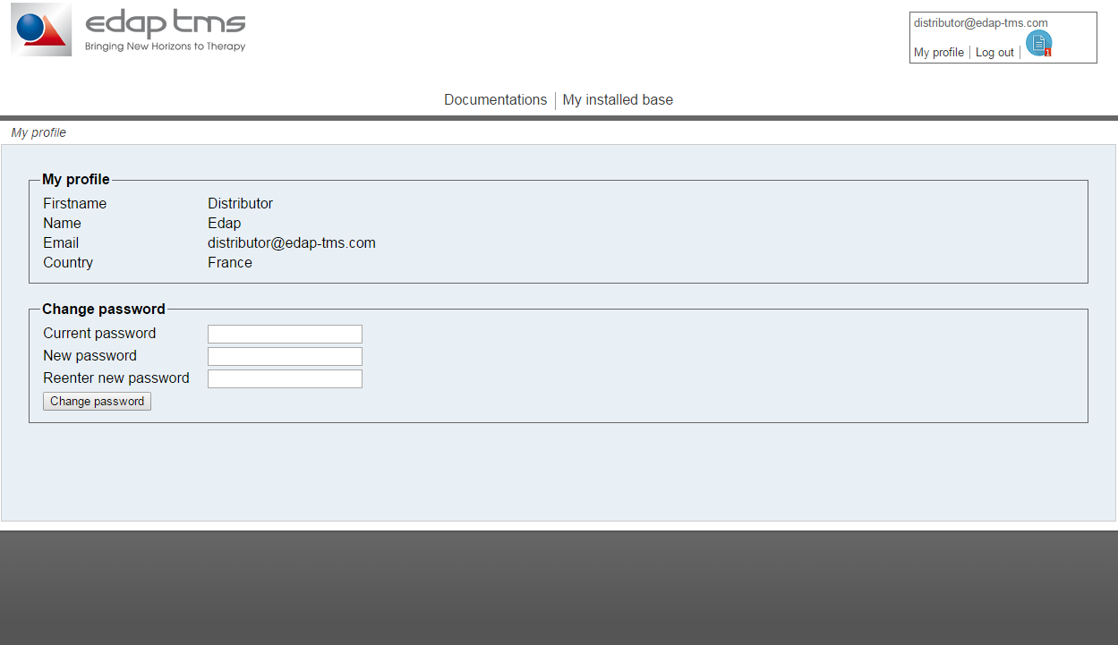
My Profile
If you have a problem on your account contact us
Change your password easily with this form

Slide 13
My install base
To reach the documentation page click here

Slide 14
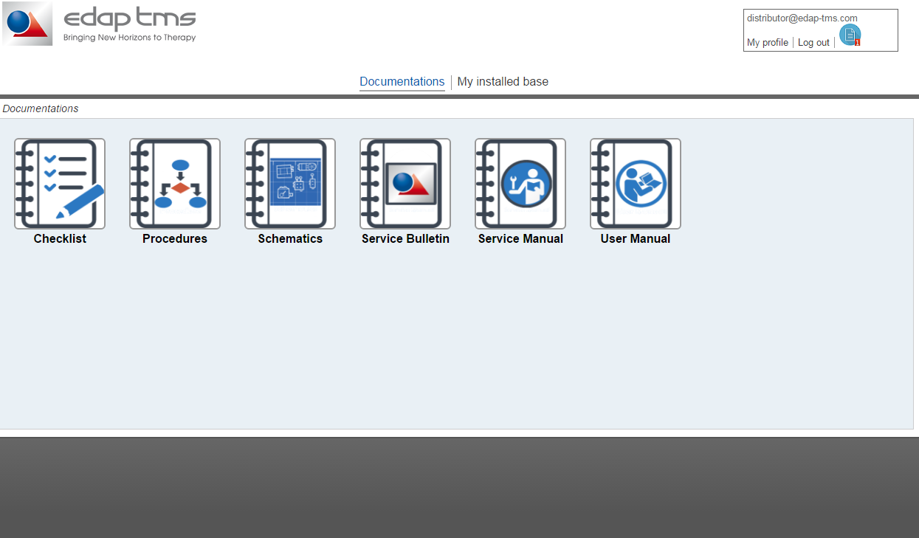
My documentation
All documents of the machines will be available on these menus. Please seeck here before posting a support request

Slide 15
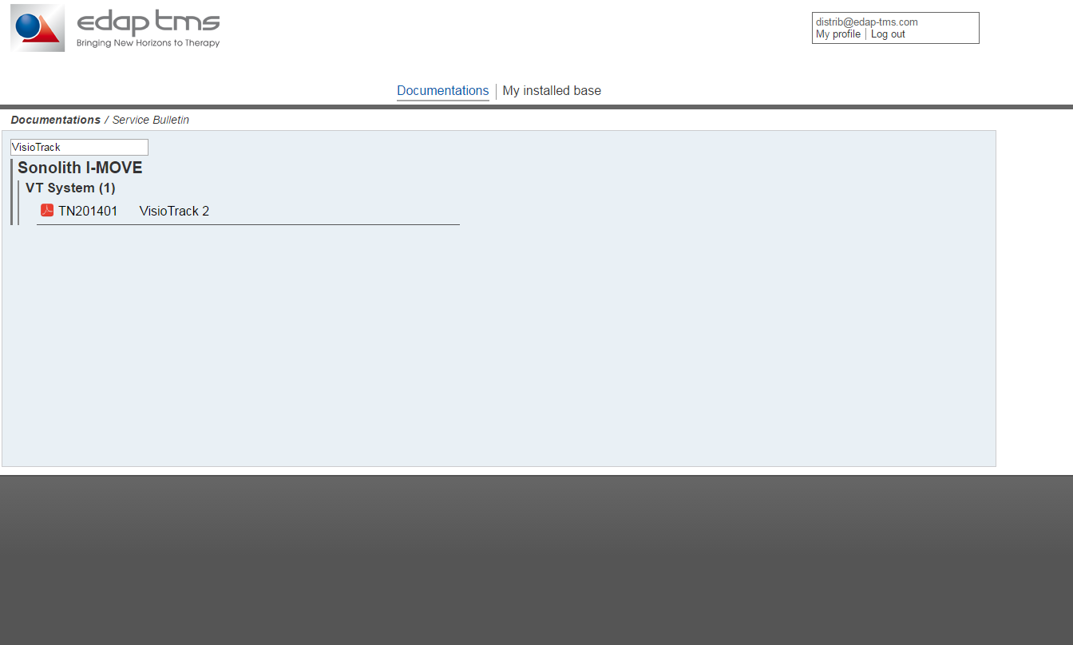
My documentation
You can search a document here.
You can type the date the type or a part of the description.

Slide 16
Incident management
To Reach the incident management page click here

Slide 17
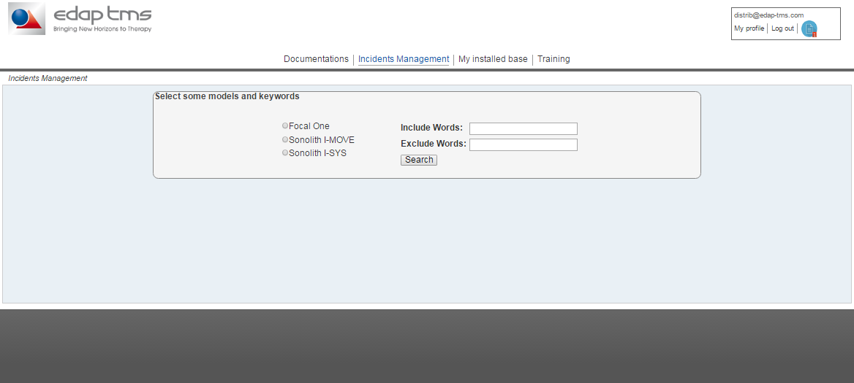
Incident management
Fill this form and click on search

Slide 18
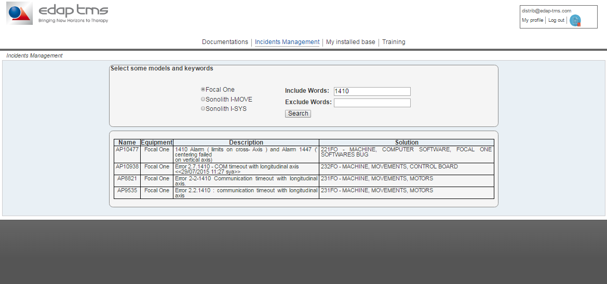
Incident management

Slide 19
My installed base
To review your installed base click here

Slide 20
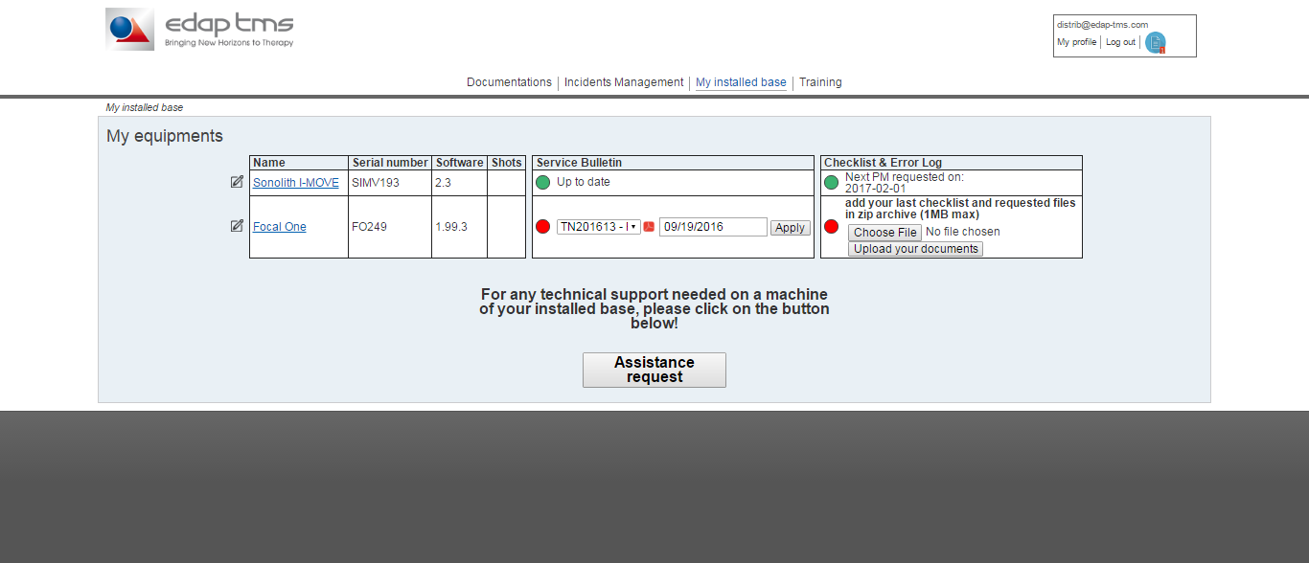
My installed base
Click on the button to open a support request

Slide 21
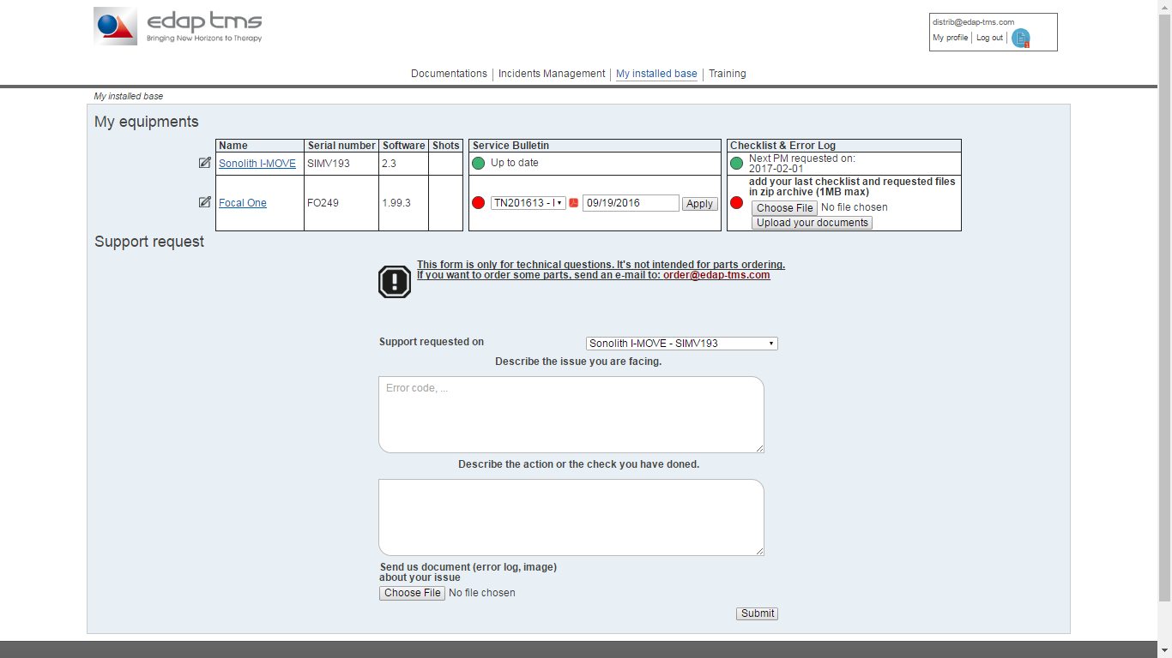
My installed base

Slide 22
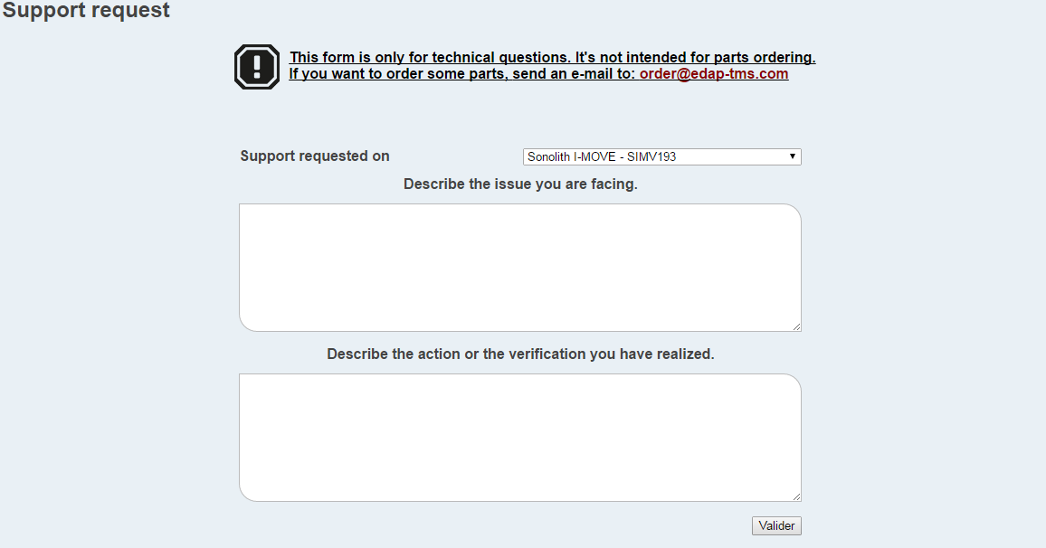
Mailling Form
Select the machine you having issues on
Fill these 2 fields and Submit the form. This will send us an email.

Slide 23
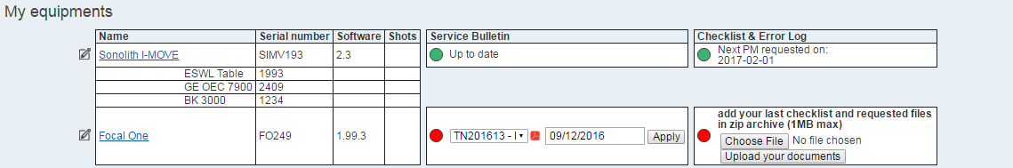
Your system
Click in this area to access the information about the peripheral
Attach the document requested in the PM checklist (error log, technical files, follow up) in a zip archive

Slide 24
Your system
Click here when you need to modify information about your system.

Slide 25
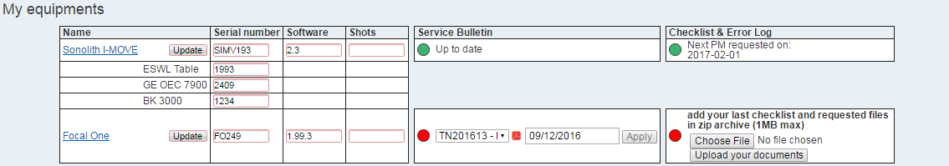
Your system
When all information are updated click here

Slide 26
Book a training
To reach the training page click here

Slide 27
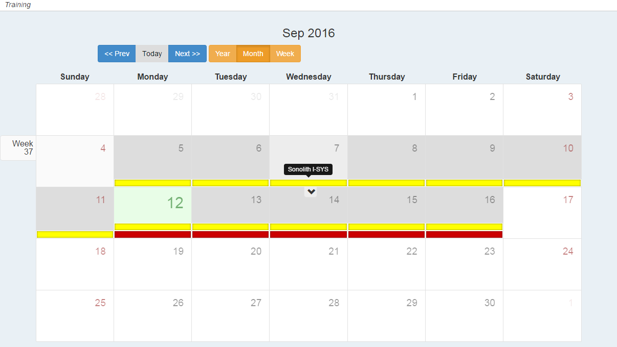
Book a training
These buttons are made to scroll the calendar
These buttons are made to switch the views of the calendar

Slide 28
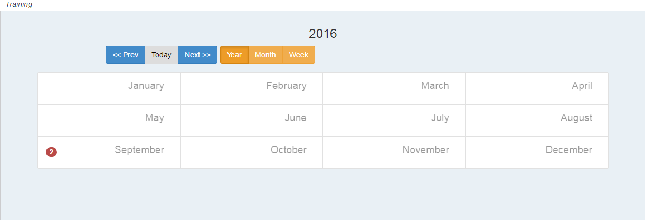
Book a training

Slide 29
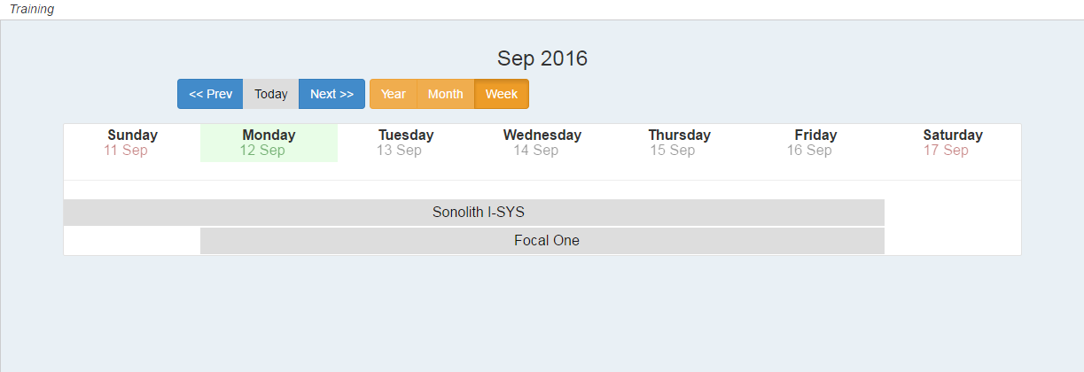
Book a training

Slide 30
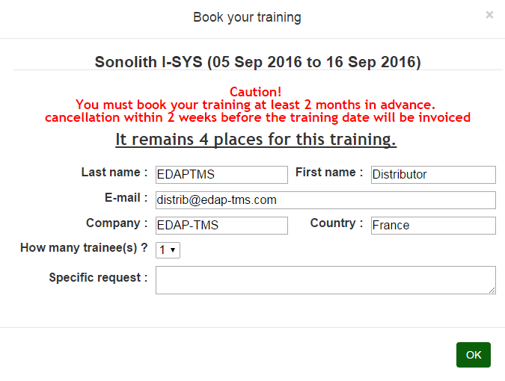
Book a training
Fill this form to book your training

Slide 31
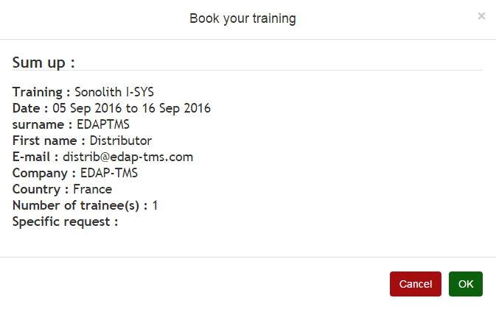
Book a training
Verify if all informations are correct
If everything is OK submit with this button
If you want to modify a field click here to go back

Slide 32
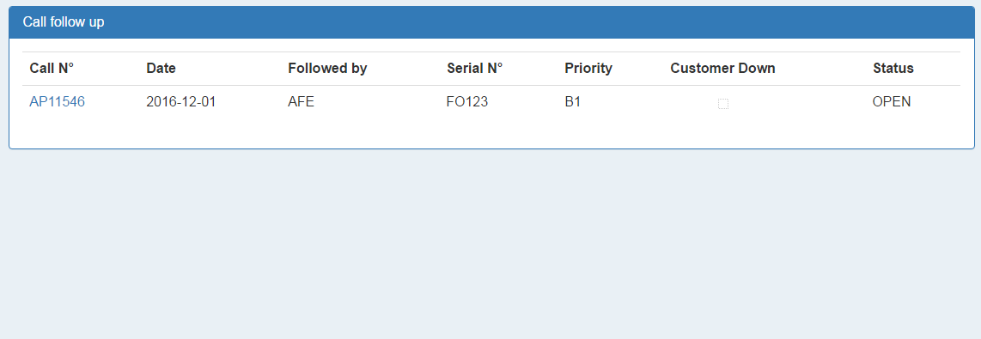
Follow your call
This is your dashboard for call.

Slide 33
Device Software Record

Slide 34
What is a DSR
The DSR or Device Software Record is a document available in all updating CDs. In theses documents, you will find all information about the new update (Ex. : New software versions, new correction, …) you will also find the procedure for all software that need to be updated.

Slide 35
Service Bulletin

Slide 36




What is a SB
The SB or Service Bulletin is a document that inform you about new correction for the device. Actually, 4 level of service bulletin can be sent.
  The technical note
  The mandatory action required
  The field corrective action
  The field safety corrective action

Slide 37
The Technical Note (TN)
TN : Technical Note :
This is the notification for technical evolutions of a device. We write the description of the modifications brought during
manufacturing process, specifying the scope, with serial number.
Technical Notes are not referring to any safety, nor regulatory matters.
Acknowledge of receipt form has to be returned after reception.
Completion form has to be filled if the device is upgraded to the latest version.

Slide 38
The Mandatory Action Required
MAR : Mandatory Action Required
This is the notification for a mandatory action which has to be taken immediately.
MAR are referring to regulatory matters.
There are 2 categories:
  New releases of documents, like the maintenance checklists.
  MAR can also be a technical modification that is mandatory assessed, without safety impact for FSE during maintenance (Field Support Engineer), nor for the users nor the patients as following :
    Software update
    Compliance (low criticality]
    All corrective action for reliability improvement
Acknowledgement form has to be returned upon receipt of the bulletin.
Completion form has to be returned once the device is upgraded to the latest version.
Deadline for realization and return of completion form within the specified delay.
This event is not reportable to local regulatory affairs.

Slide 39
The Field Corrective Action
FCA : Field Corrective Action
This is the notification for a corrective action which has to be imperatively applied, with a specified deadline.
FCA is referring to regulatory or potential safety matters.
Split in 2 levels
  Technical : Design has to be corrected because of malfunctions having potential risk for FSE, users or patient, or to solve repetitive failures, with treatment cancellation.
  Regulatory : Design has to be corrected to meet compliance rules.
This event is potentially reportable to local regulatory affairs.
Deadline for return of acknowledgment, realization and completion form within the specified delay
Customers MUST be notified through a Letter of which we will draw a template.

Slide 40

The Field Safety Corrective Action
FSCA : Field Safety Corrective Action.
It has been identified a serious risk for the users and /or the patient.
Systems must not be used until a safety control or a modification has been performed .
Deadline for modification as specified .
It is mandatory to report this event to regulatory affairs for all concerned countries.
Deadline for realization is within 1 month.

Slide 41
Software Update

Slide 42
Refer to the last
Software Service Bulletin

