Slide 1
Technical Training
FocalPack

Slide 2
FocalPak

Slide 3
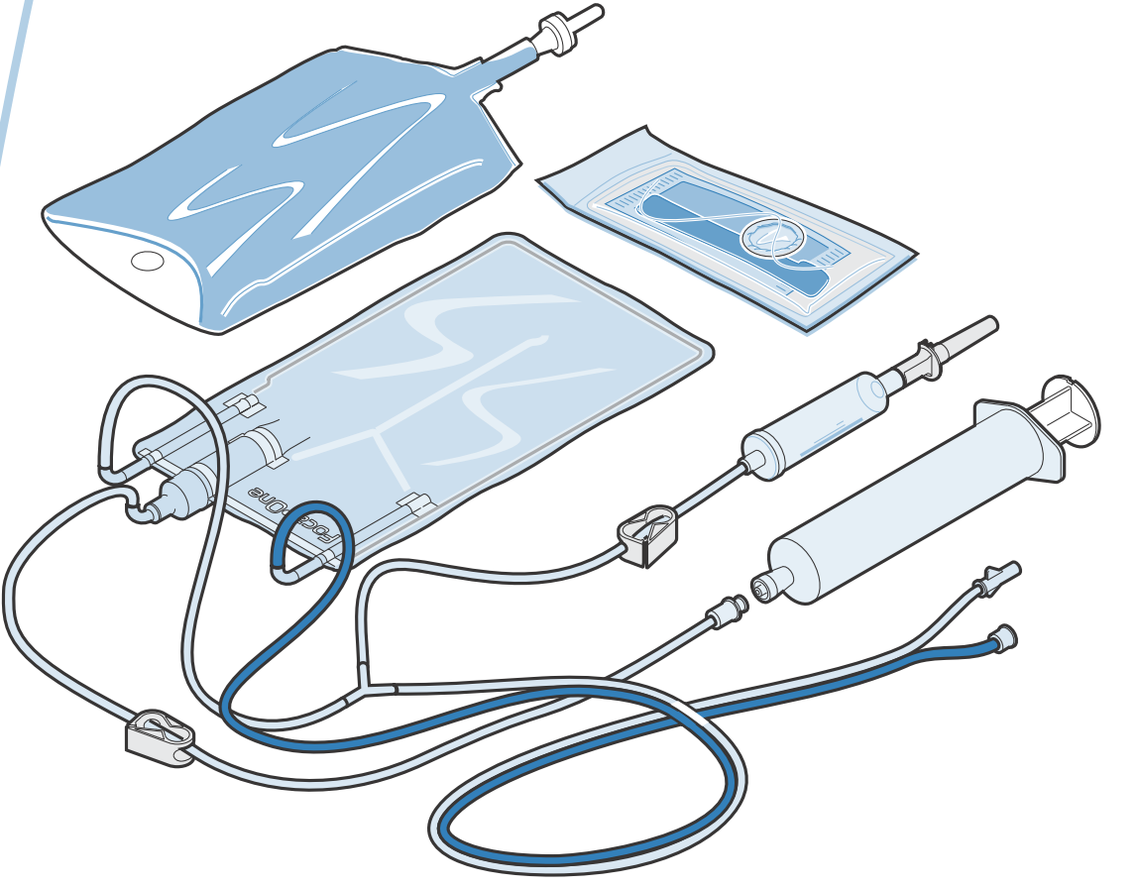
COMPOSITION

Slide 4
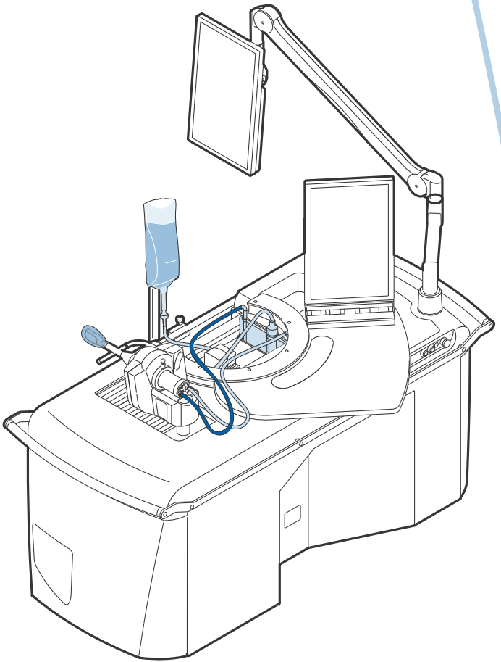
IN PLACE

Slide 5
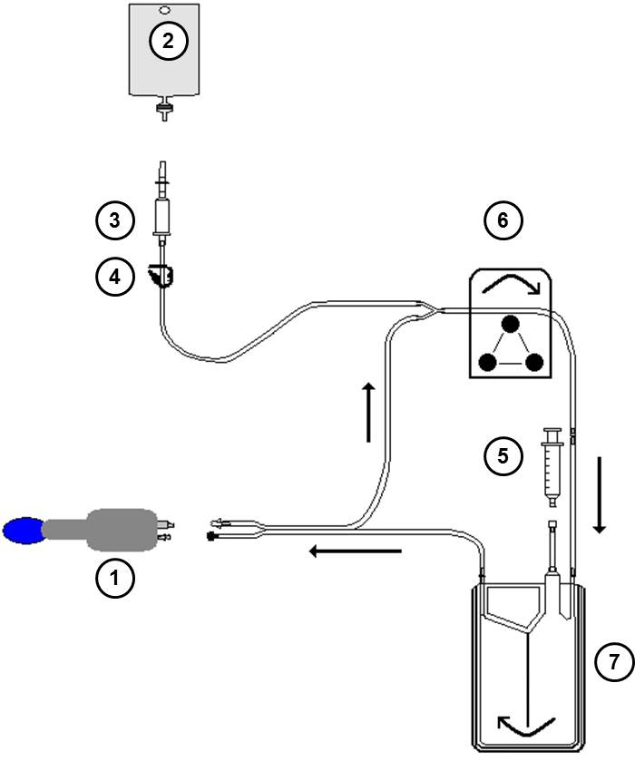
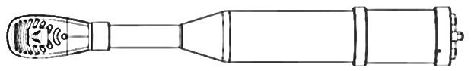
IN PLACE
❶ Treatment probe
❷ Ablasonic®.
❸ Perforator.
❹ Clamp.
❺ Syringe.
❻ Pump.
❼ Exchanger punch.

Slide 6
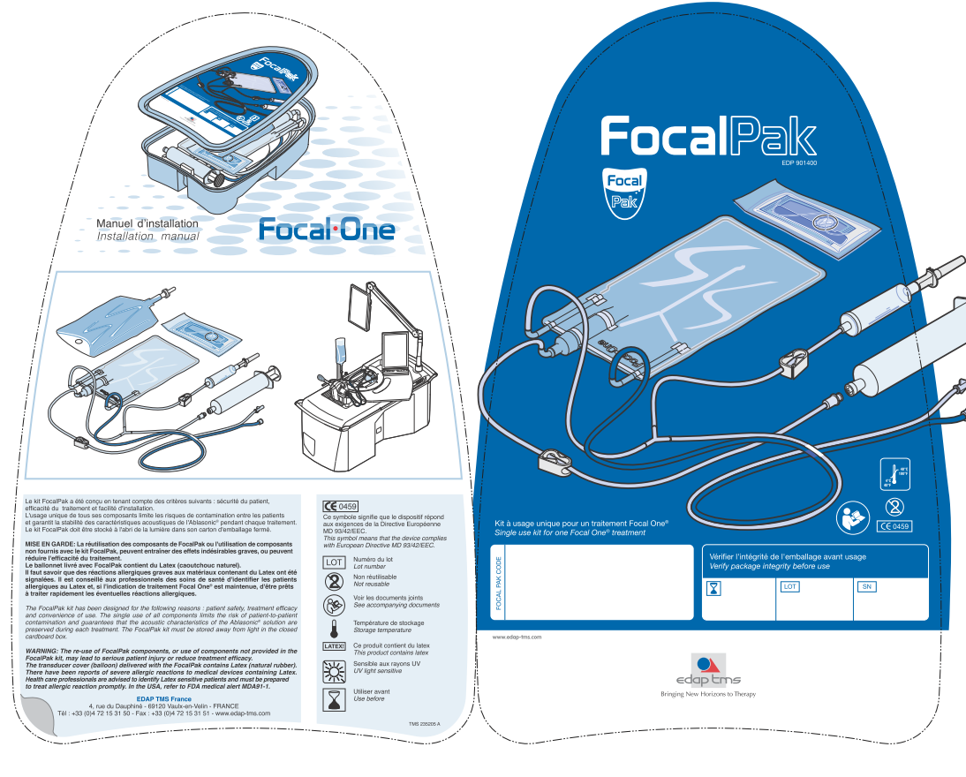
LEAFLET - FRONT
Focal Pak
Code

Slide 7
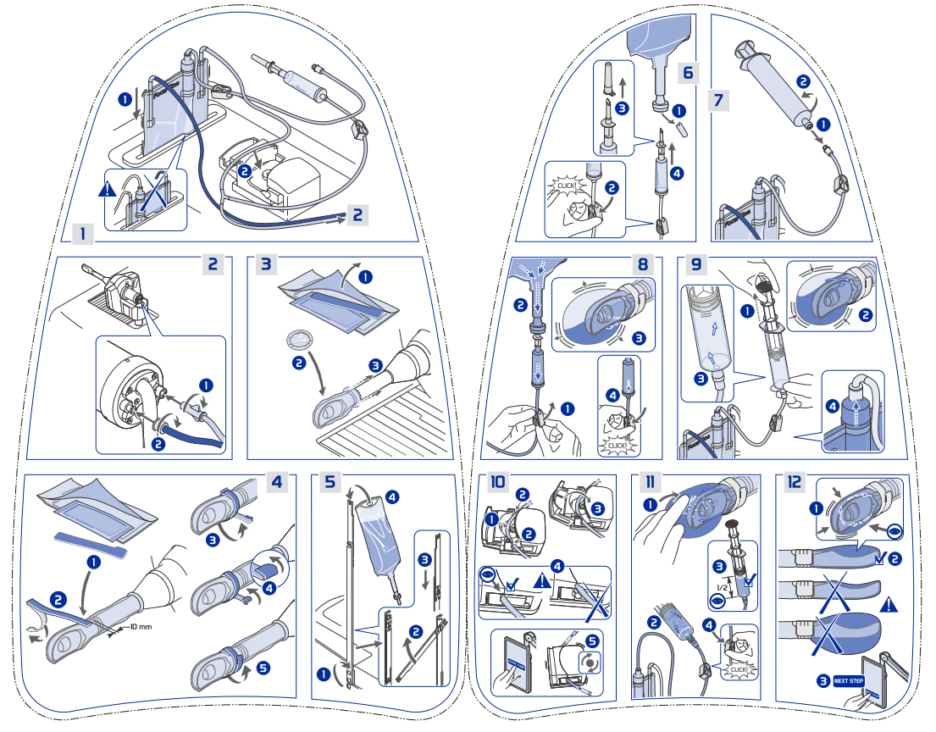
LEAFLET - REAR

