Slide 2
Technical Training

Slide 3
Introduction

Slide 4
Some history
EDAP
1982 First machine 1986 LT01 (LITHOTRIPTER)
1992 LT02
1994 ACQUISITION OF TECHNOMED MEDICAL
SYSTEMS
TECHNOMED
1986 SONOLITH
1988 PULSOLITH
1989 PROSTATRON
1990 ACQUISITION DE MEDICAL LASERS
(MICROCONTROLE)
1994 ACQUISITION PAR EDAP
EDAP TMS
1998 Sonolith Praktis
1999 Ablatherm
2001 Sonolith Vision
2007 I-Sys
2008 17 000 patients treated by Ablatherm
2010 I-Move
2013 Focal One

Slide 5
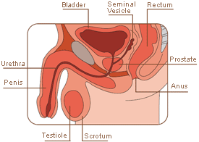
Anatomy: protate and bladder

Slide 6
Diagnosis of prostate cancer
A doctor will perform a digital rectal examination of the prostate to feel for any abnormalities such as hardness or increased size. A doctor will also carry out a blood test to record levels ofprostate specific antigen (PSA). PSA is a protein produced by both normal and cancerous prostate cells and high levels of PSA can be a sign of cancer. The PSA test identifies tumors that cannot be detected by digital rectal examination (about 30% of cases of all prostate cancers). Some cancers are detected during tests for benign prostate hypertrophy.
An urologist may carry out further tests for confirm a prostate cancer diagnosis:
Prostate biopsy: a sample of prostate tissue is removed with a fine needle for examination.
MRI or CT scan: imaging of all body organs to detect for possible cancer in the lymph nodes, liver or other organs.
Bone scan: imaging of all bones to check for any cancer in the bones.
BIOPSY
Bladder Neck
Middle
Apex
GLEASON : SCORE
Sum of 2 samples scores (on a 1 to 5 scale for each)
Result between
2 (low risk) - 10 (high risk)

Slide 7




Classifiation of cancers
Localized prostate cancer (stages T1 or T2): the tumor is confined to the prostate (intracapsular)
 | Stage T1 Only a few cells have turned cancerous and so cancer can only be detested via blood tests or a biopsy. The cancer is not revealed by a rectal examination.
 | Stage T2 The cancer is a little bigger and makes the prostate gland harder. A doctor can now detect the cancer during a rectal examination.
Locally advanced prostate cancer (stages T3 and T4): the tumor spreads into surrounding organs
 | Stage T3 The prostate cancer has spread to the shell of the prostate gland.
 | Stage T4 The prostate cancer has spread outside the prostate and possibly to other organs.

Slide 8
Treatment of prostate cancer
Surgery (radical prostatectomy)
The whole prostate is removed with the seminal vesicles (which produce semen), the connected canals (which carry the sperm), part of the neck of the bladder and the surrounding lymph nodes. Surgery requires a general anesthesia and lasts about three to four hours.
External radiotherapy (radiation therapy or EBRT)
This treatment involves the use of radiation (very high energy rays) directed at the prostate gland to kill cancerous cells. Healthy cells have a special repair mechanism if affected by this type of radiation but cancer cells do not so are killed. Radiotherapy does not require anesthesia and treatment is generally given during regular visits over several weeks.
Brachytherapy
This treatment involves the implantation of tiny radioactive seeds directly into the prostate gland to irradiate and destroy the cancer cells.
Cryotherapy
Guided by ultrasound, the prostate gland is frozen solid killing the cancerous cells. The procedure is done under anesthesia and requires at least an overnight stay in hospital.
Hormonal Therapy
High Intensity Focused Ultrasound
High Intensity Focused Ultrasound (HIFU) is a minimally-invasive treatmentfor localized (contained) prostate cancer. Ultrasound waves are focused with extreme precision instantly and effectively destroying the targeted cancerous cells in the prostate. The ultrasound waves are delivered via a probe which is inserted into the rectum (back passage). The treatment lasts one to three hours and can be performed under general or spinal anesthesia.

Slide 9
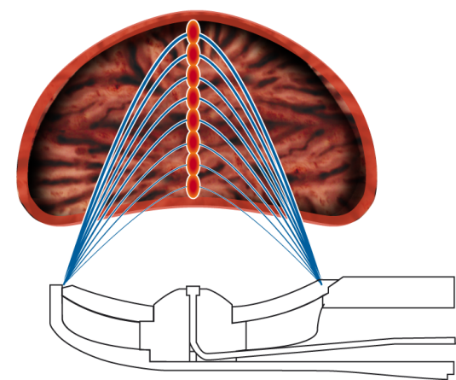

HIFU treatment: principle
The emission is based on a mechanical vibration of several piezoelectric transducers inducing waves and an acoustic pressure in the propagation medium.
These acoustic waves, while crossing tissues, lose energy which is converted into heat.
The transducer presents an ellipsoidal form.
By applying particular laws of phase to the electrical signals supplying the transducers, the point of focusing (called “Focal point”) can be changed dynamically from 32 mm to 67 mm.
The U/S prostate imaging is carried out using the U/S transducer laid out in the center of the treatment transducer.
The U/S transducer is an electronic array at 7.5 MHz, making transversal plane images.
A scan in the longitudinal direction generates a series of transversal images which are combined to form a longitudinal view of the prostate. From these images, longitudinal sections are rebuilt as well as a precise three-dimensional volume of the prostate.

Slide 10
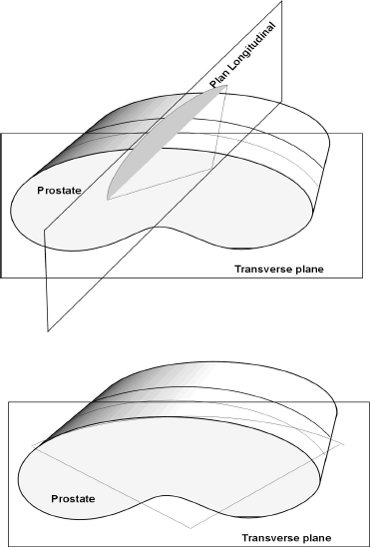
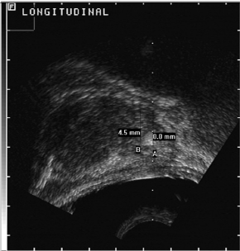
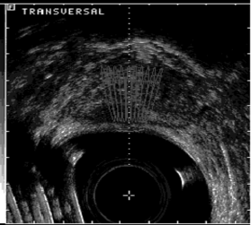
U/S Scanner views:

Slide 11
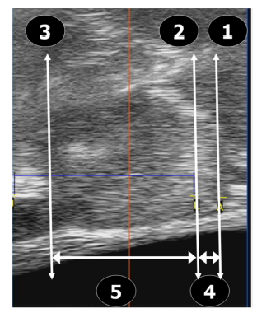
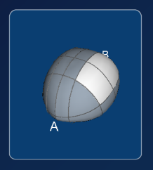
Treatment planning: prostate division
A slice is 1,7 mm thin
1. Anatomic Apex (sphincter): « A » point.
2. Lower limit or treatment apex: « L » point.
3. Upper limit: « U » point.
4. Safety distance: « A-L » distance.
5. Treatment aera: « L-U » distance.

Slide 12
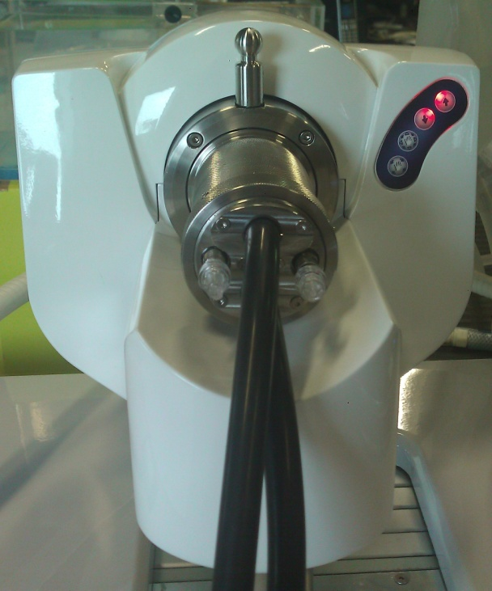
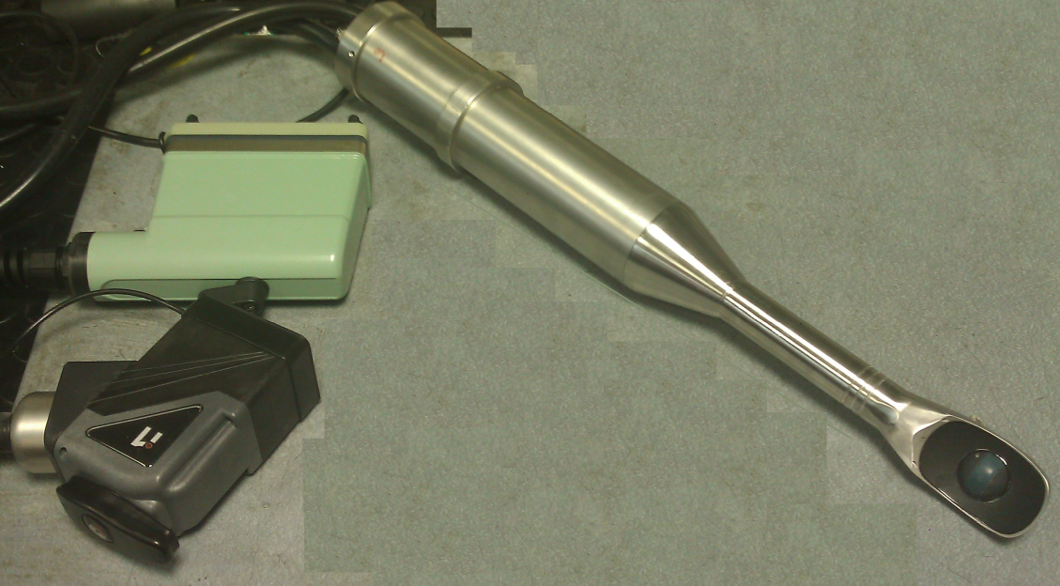
Treatment probe
Connections: Ablasonic liquid’s circulation, connection to U/S scanner, RF amplifier and probe data.
Probe contains: PT100 temperature sensor, 16 channel transducer cell, Type 6030 U/S cell, Ablasonic duct, electronic board for probe’s data

Slide 13
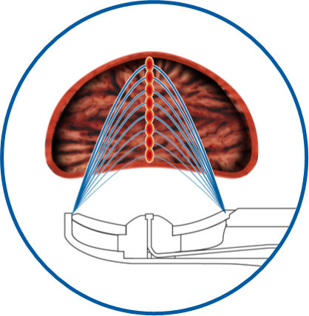
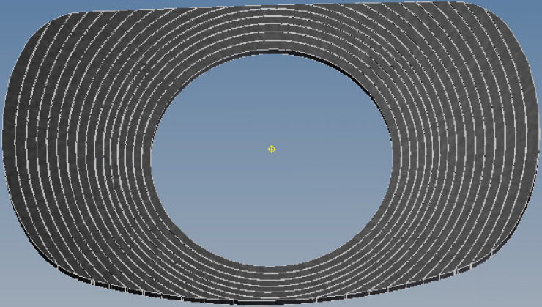
Treatment planning: prostate division
  8 focal points from 32mm to 67mm (△f = 5 mm)
Unitary HIFU lesion stacking
Shooting process : 1s ON /foci ; no OFF
Unitary HIFU lesion height = 5mm
Max Reachable depth (A-P Distance): 40 mm
  16 isocentric rings = 16 ways
  Equal surfaces
  Electronic displacement of focal point
  Natural focal point @ 60 mm

