Slide 1
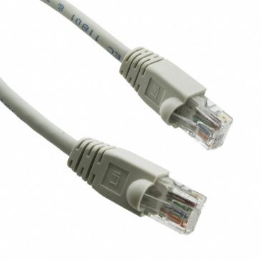
Pasos para completar el fin de establecer un vínculo entre todos los dispositivos FibroScan ® (FS 402, FS 502 y FS 502 Touch) y PC
Customer or biomedical engineer will need :
This manual
A RJ 45 Cable
15 minutes for set up

Slide 2
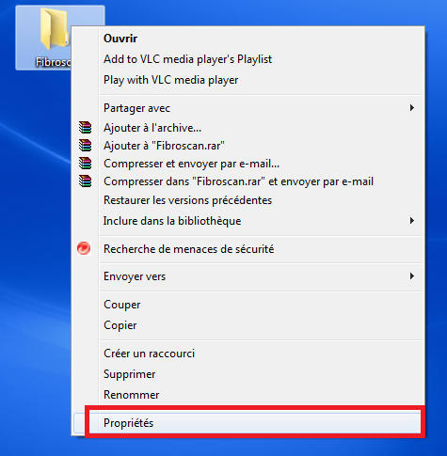
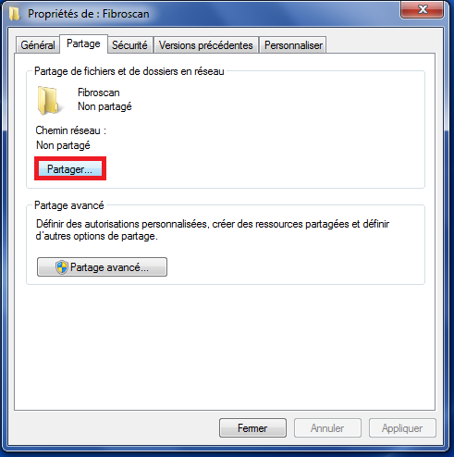
1)
On the desktop,create a « Fibroscan»
Folder, then left click and click
2)
Click on « Share » tab and then on Share button

Slide 3
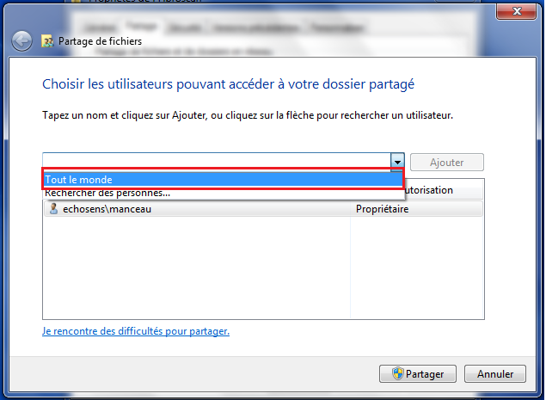
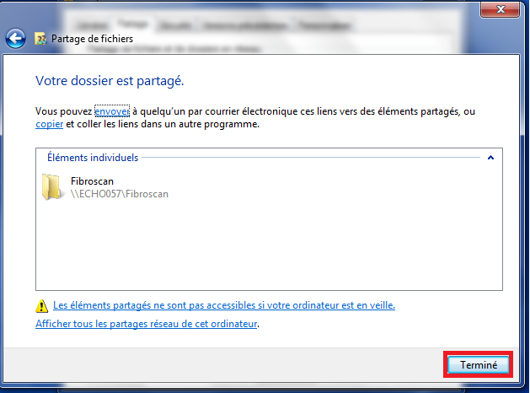
3)
Select « Everyone » and click the « Share » button
4)
This folder is now Shared.
Click on Finish

Slide 4
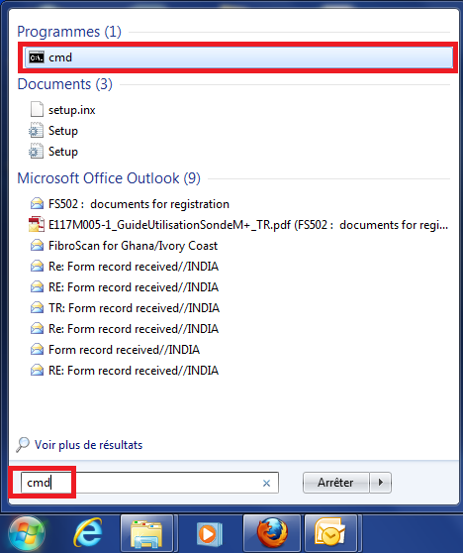
5) IP Address
If the customer does not know the IP address of his computer, which is needed for that process, he can locate it by opening a CMD (command) window

Slide 5
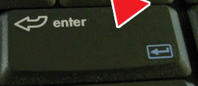
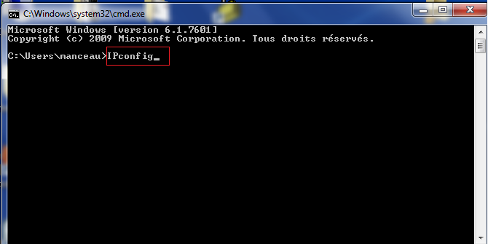
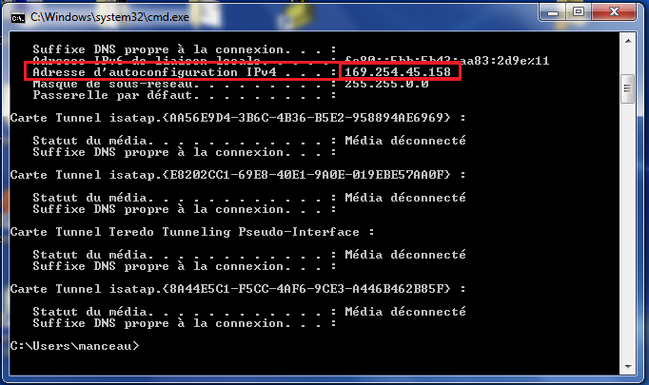
6)
Type IPconfig and press ENTER
7)
Write dow the IP address that pops up
+

Slide 6
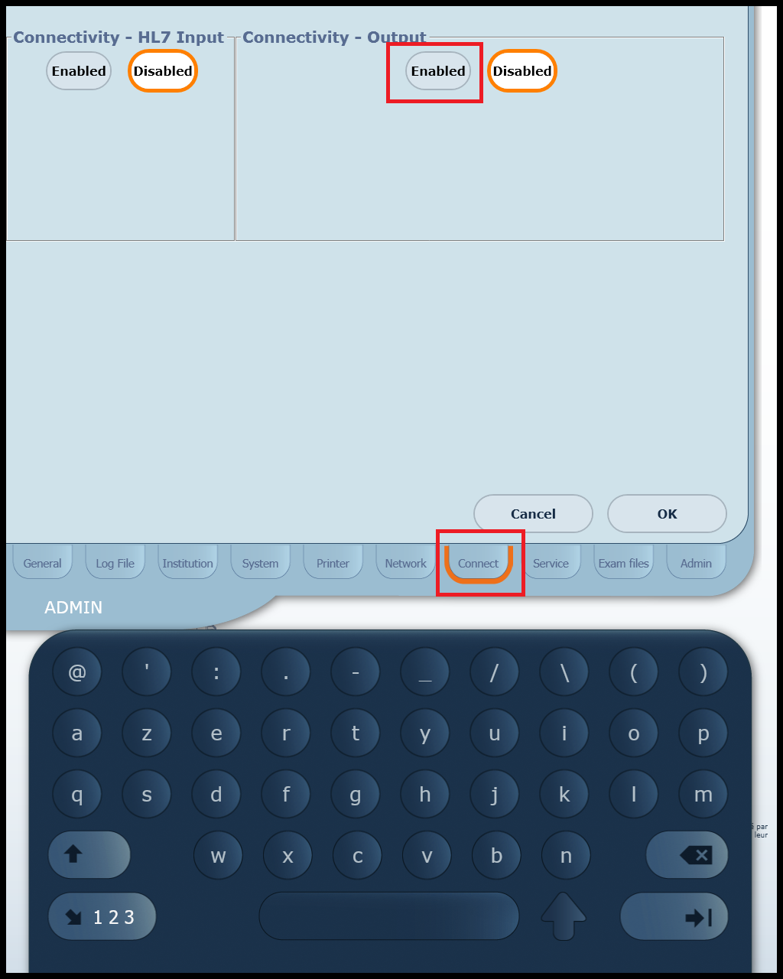
8)
Connect the RJ 45 cable to the computer and the device.
Enter configuration Mode under BIOMEDICAL ENGINEER
Click on tab and click on
in Connectivity – Output tab

Slide 7
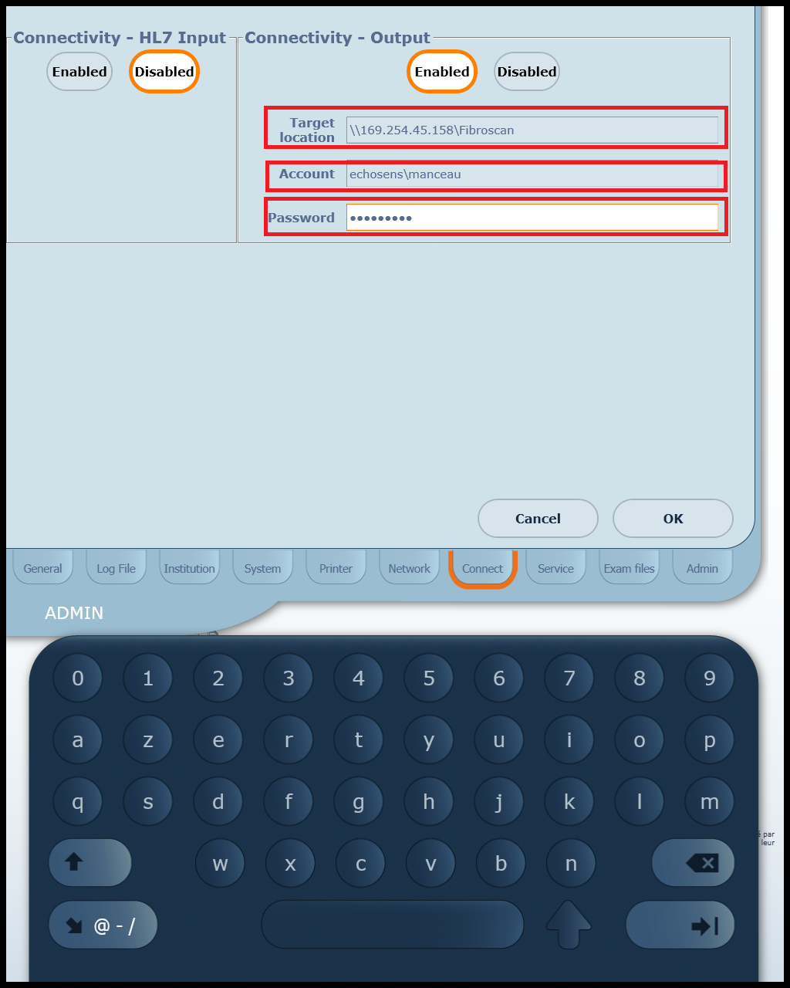
9)
In Target Location Cell, enter :
\\IP address\foldername
(enter the share name of the folder. It can be different from the folder name )
In Account , type Username entered when opening a windows session
In Password, enter the password used to log on your windows session You can click on the TEST button if available (CLPC A2.0.2)
or Click OK
Should an error message appear, please spellcheck typo. i.e: CAPS LOCK, exact IP Address N° etc…

Slide 8
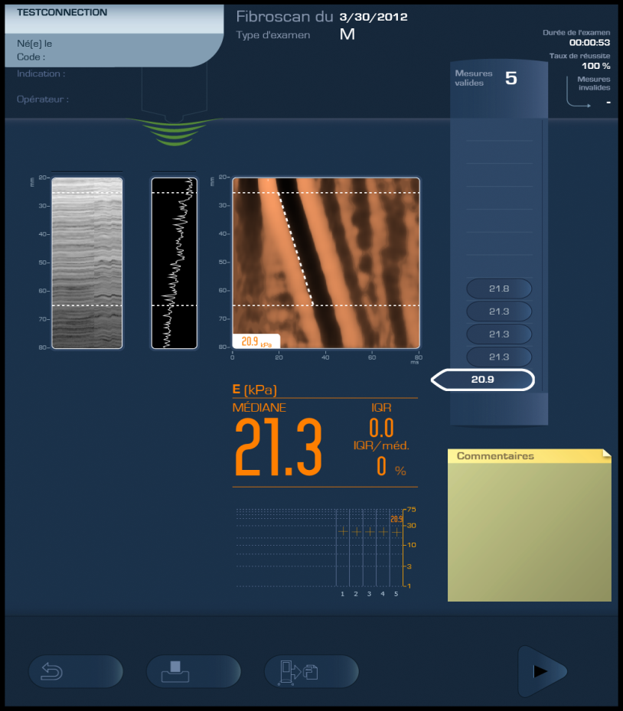
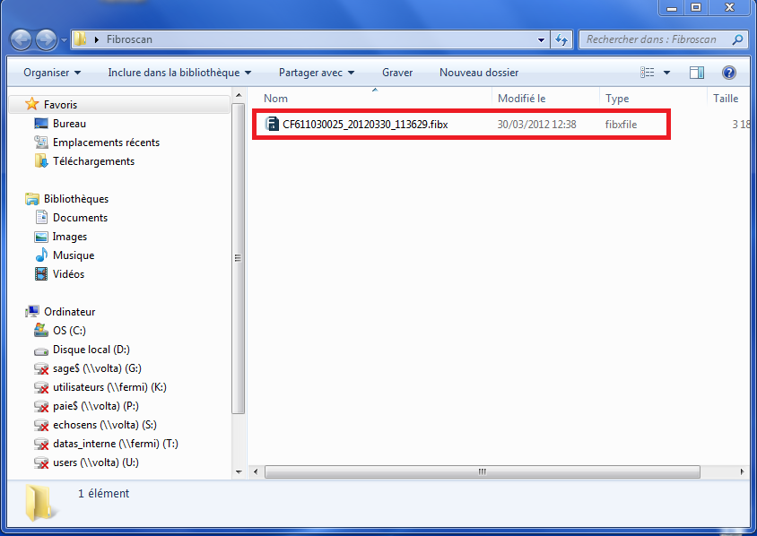
10)
Now everytime cable is connected and and examination is ended,
FIBX file is pushed to the fibroscan folder created on the desktop
Please note that if the cable is disconnected, files won’t be pushed to PC
However, once reconnected, at the moment of the first push, all the files « pending » that could not be exported whilst disconnected will be pushed at the same time.
>>Max imum of 10 exams in temporary directory

Slide 9
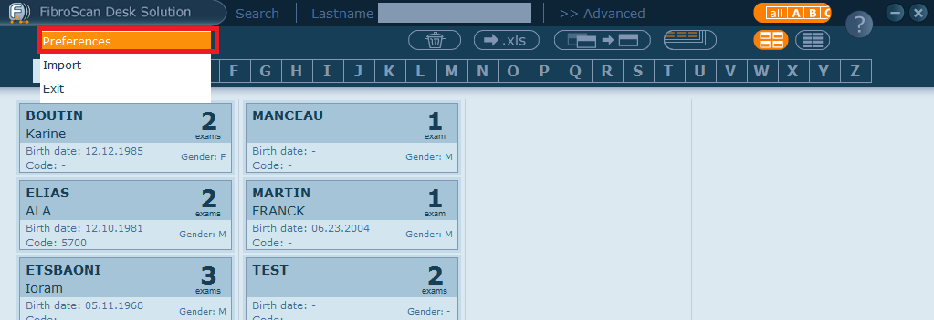
11)
Open Desk Solution software and click the item on the main menu.

Slide 10
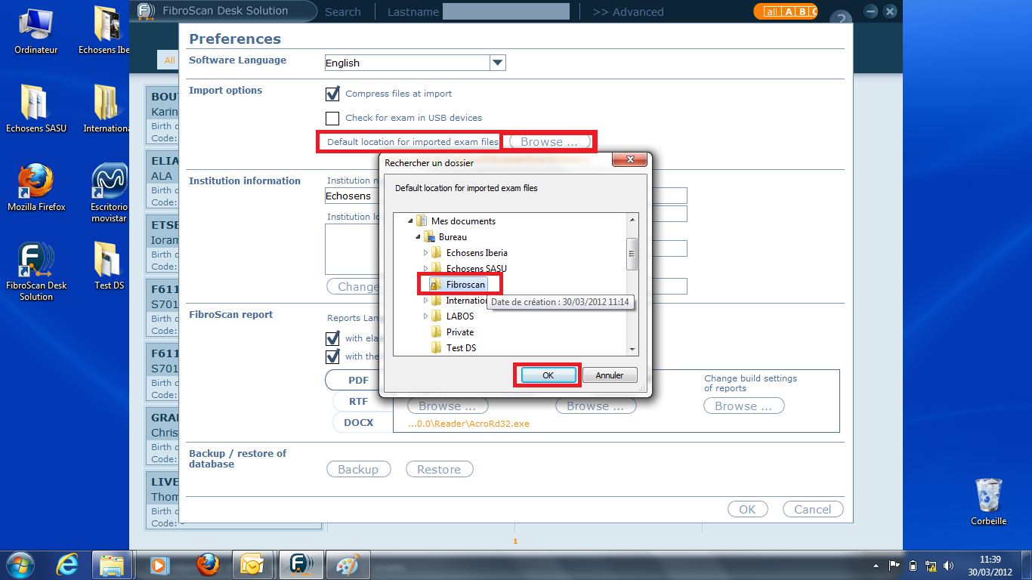
11)
Click button and select the path to shared folder where files are pushed . Click

Slide 11
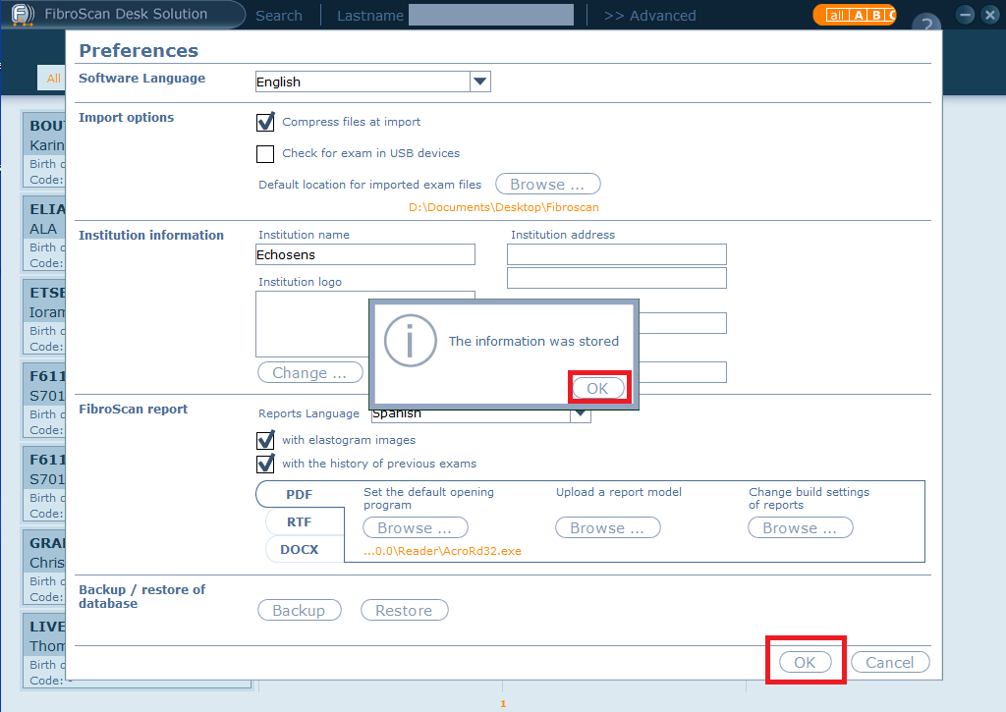
12)
Information was stored. Click

Slide 12
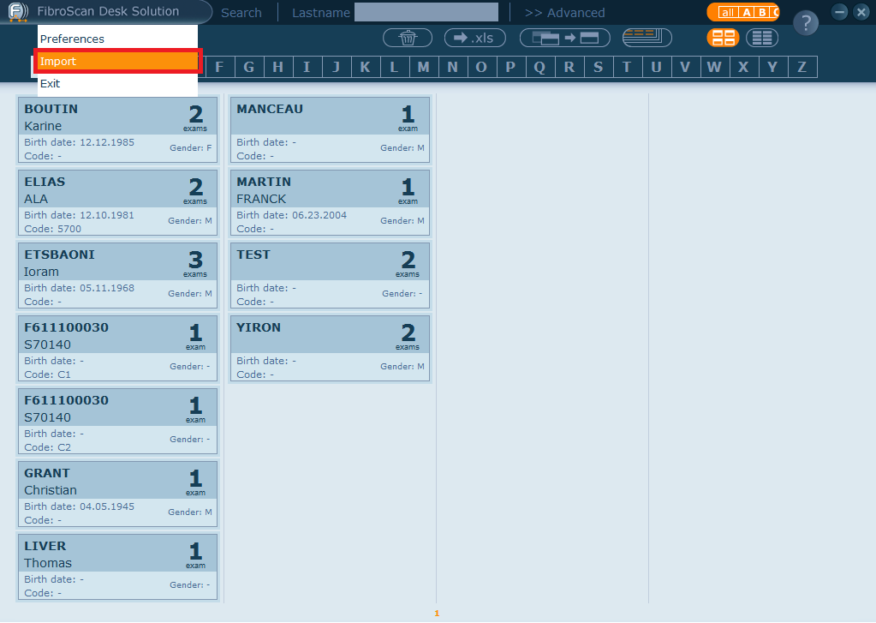
13)
Click on tab

Slide 13
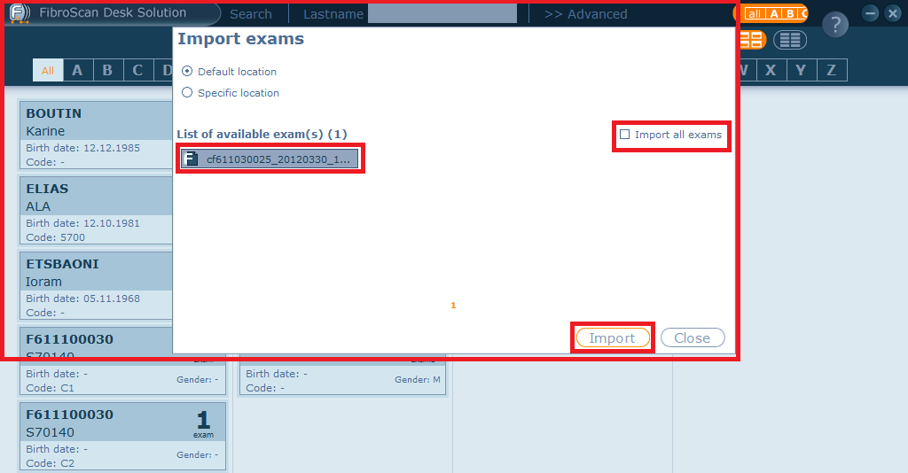
14)
All the fibx files contained in the folder will appear, you can select them one by one or tick the box and then click

Slide 14
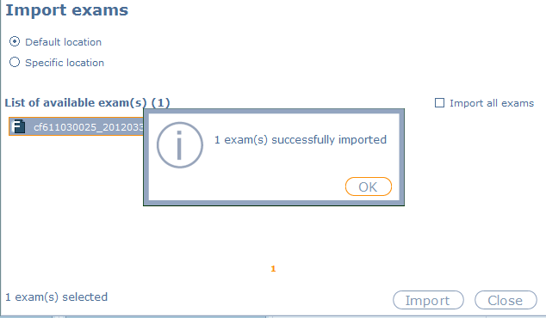
15)
The exam(s) are now readable and printable with Desk Solution

